Slide 1
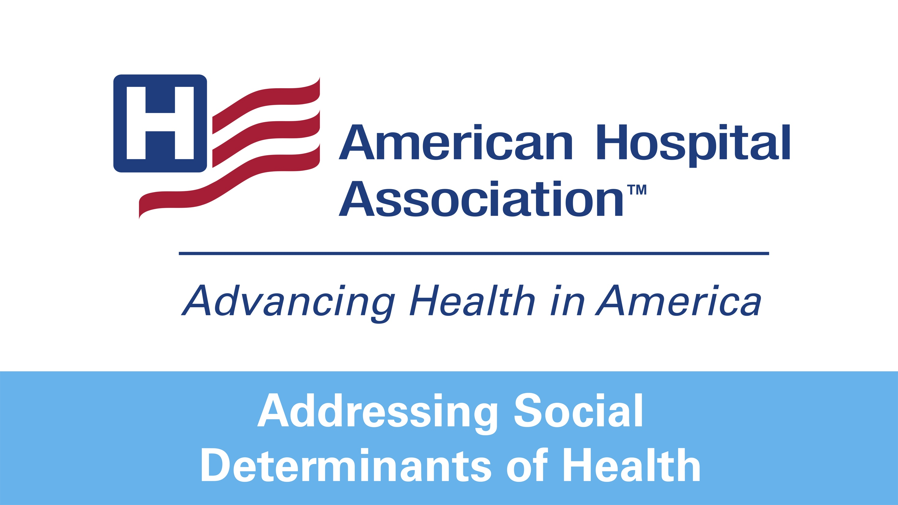

Slide 2
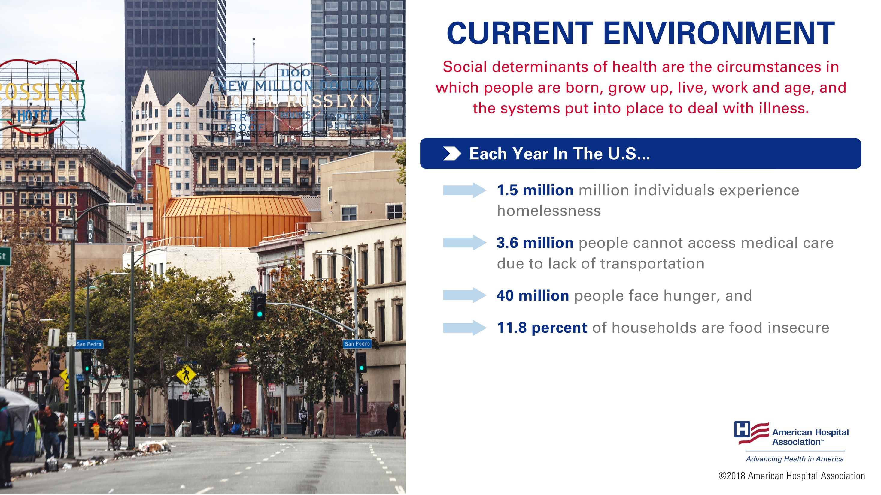
Notes:
The World Health Organization defines social determinants of health as circumstances in which people are born, grow up, live, work and age, and the systems put into place to deal with illness.
These circumstances have tremendous affect on one’s health. And, they can affect anyone, regardless of age, race, ethnicity.
For example, in the U.S. each year,
1.5 million individuals experience homelessness¹
3.6 million people cannot access medical care due to lack of transportation ²
40 million people face hunger, and³
11.8 percent of households are food insecure⁴
Imagine how those challenges impact one’s health.
1: Source: http://www.rootcausecoalition.org/wp-content/uploads/2016/11/White-Paper-Housing-and-Health.pdf
2: Source: www.aha.org/transportation
3: Source: https://www.feedingamerica.org/
4: Source: https://www.ers.usda.gov/topics/food-nutrition-assistance/food-security-in-the-us/key-statistics-graphics.aspx

Slide 3
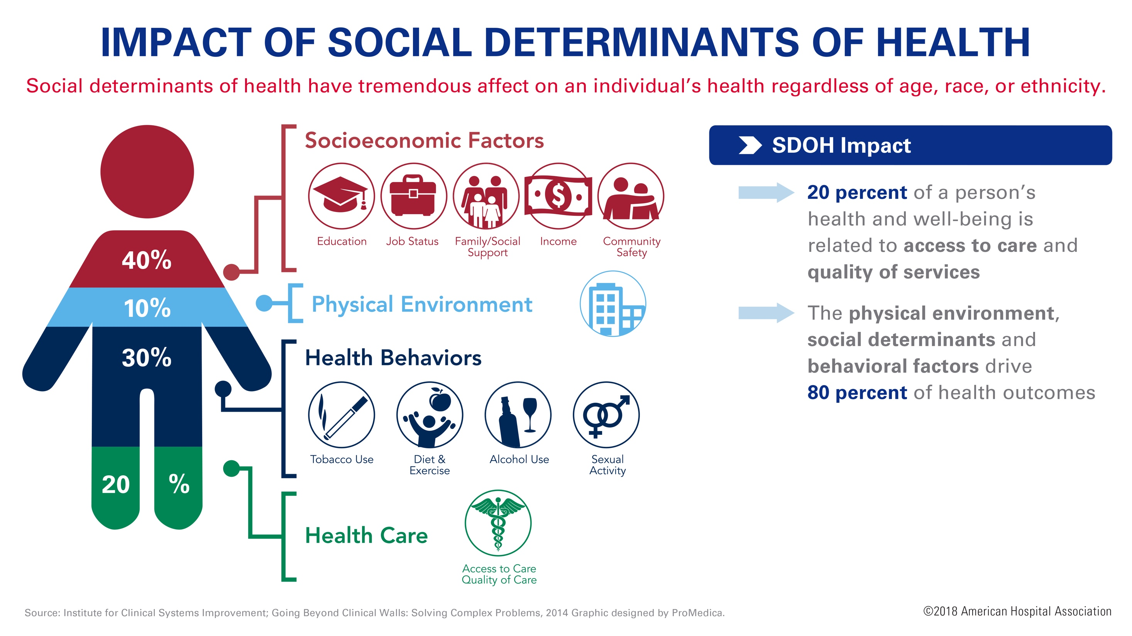
Notes:
Only 20 percent of an individual’s health is tied to clinical care, which includes access to and quality of health care services. 80 percent of an individual’s health is tied to their physical environment, social determinants – where you live, work and play – and behavioral factors – including exercise or smoking.
More specifically, that 80 percent can be broken down as follows:
Roughly 40 percent is attributed to socio-economic factors
10 percent to physical environment
30 percent to health behaviors
Source: http://www.countyhealthrankings.org/county-health-rankings-model
and https://www.icsi.org/_asset/w6zn9x/solvcomplexproblems.pdf
Image source: https://www.promedica.org/socialdeterminants/pages/default.aspx

Slide 4
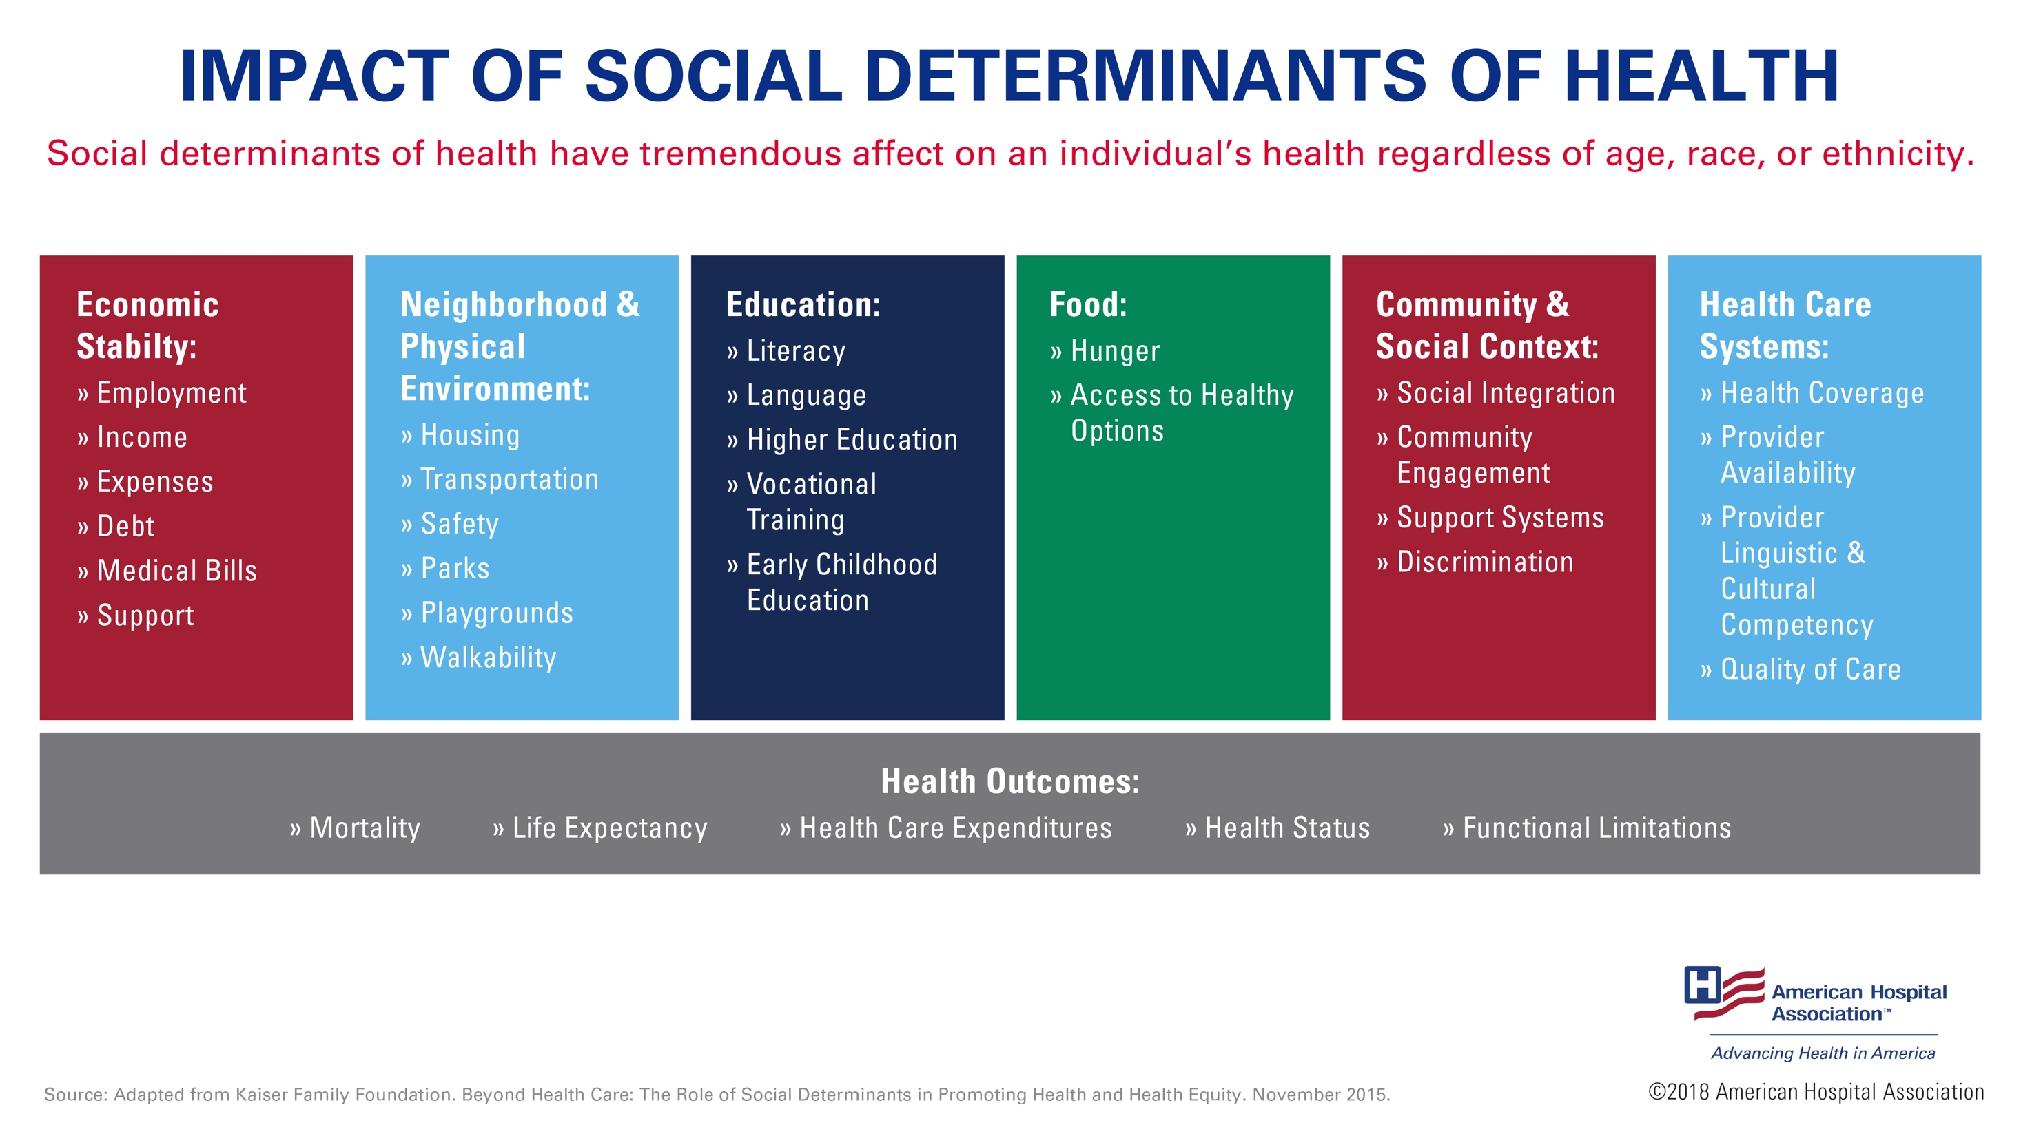
Notes:
If you are homeless, living in unsafe or unhealthy conditions, do not have transportation to get to needed medical appointments, or access to food, this greatly impacts your health.
Consider a recent study which found that children experiencing food insecurity may have two to four times more health problems than children from low-income households who are not food insecure.
Adults who are food insecure are also at an increased risk of developing chronic diseases, such as obesity and diabetes.
These poor health outcomes contribute to increased rates of readmission and noncompliance, which increases medical costs and risks.
Sources: https://www.kff.org/disparities-policy/issue-brief/beyond-health-care-the-role-of-social-determinants-in-promoting-health-and-health-equity/
and http://content.healthaffairs.org/content/34/11/1830.full

Slide 5
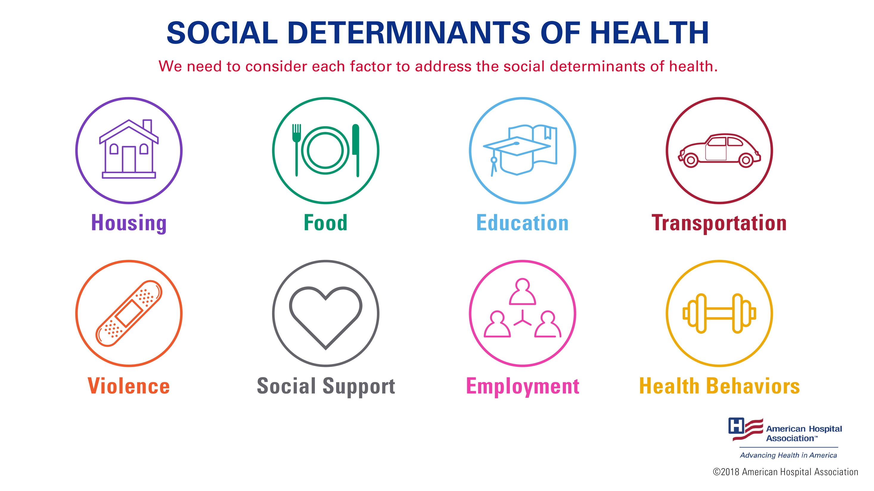
Notes:
Each of the areas represented on this slide represents struggles many in our communities face. And each is also a barrier to good health. To improve people's health and well-being, we need to consider these factors and address the social determinants of health.
We know social determinants have a bigger impact on a person's health than clinical care. Therefore, we must support practices that address these key issues as part of a successful population health strategy.

Slide 6
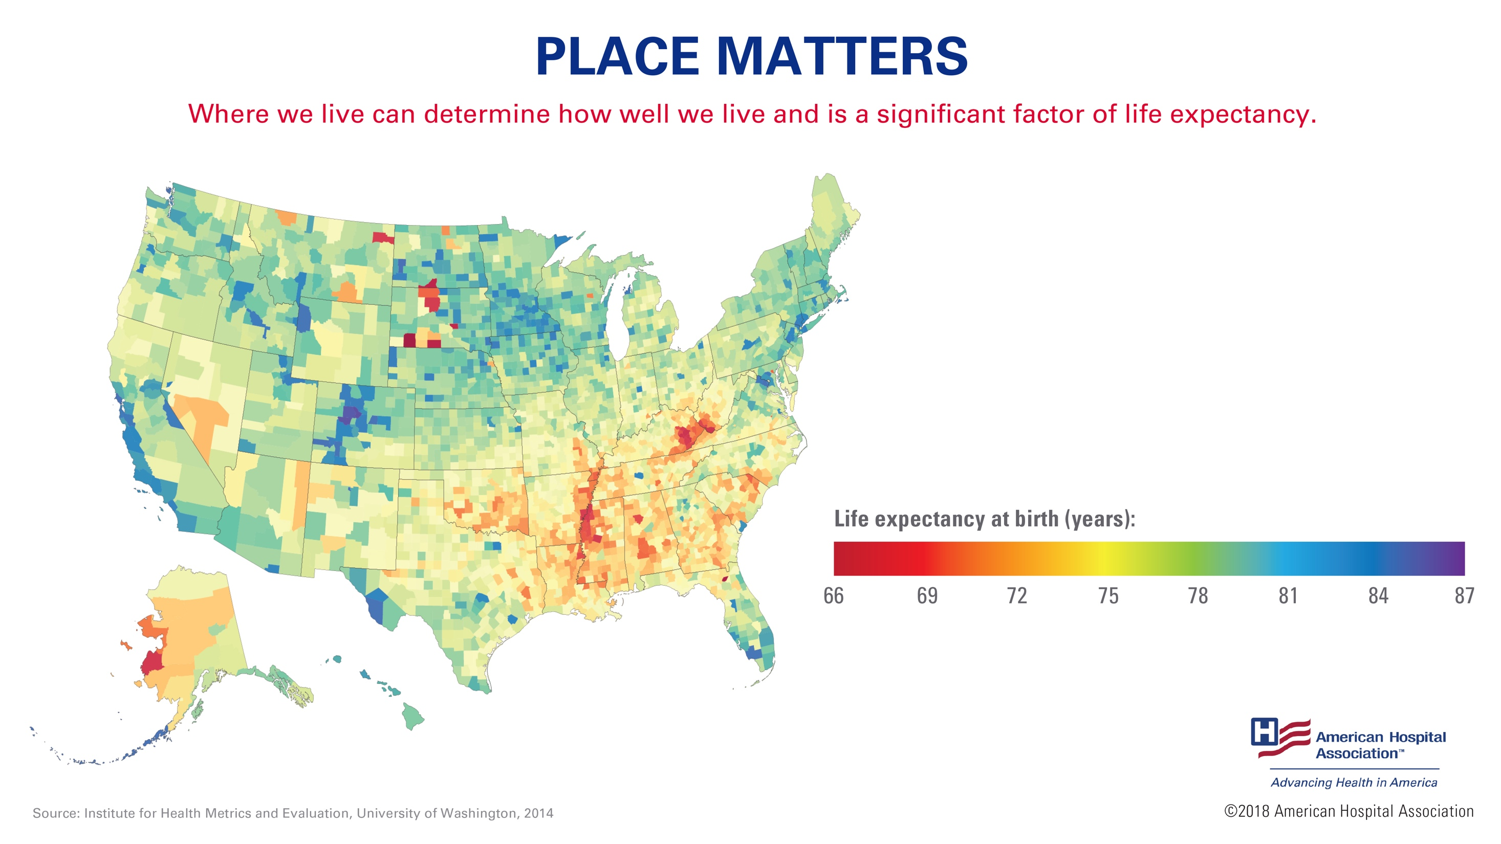
Notes:
Let’s dive a little deeper into the impact the social determinants can have on our well-being.
First, place matters. Where we live can determine how well we live and is a significant factor of life expectancy.
This map illustrates the range in life expectancy among counties in the United States, going from 66 in red to 87 in blue. In some cases, the difference can exceed 20 years. For example, life expectancy rates are lower in southern states than they are in northern states.
Source: Institute for Health Metrics and Evaluation, University of Washington, 2014

Slide 7
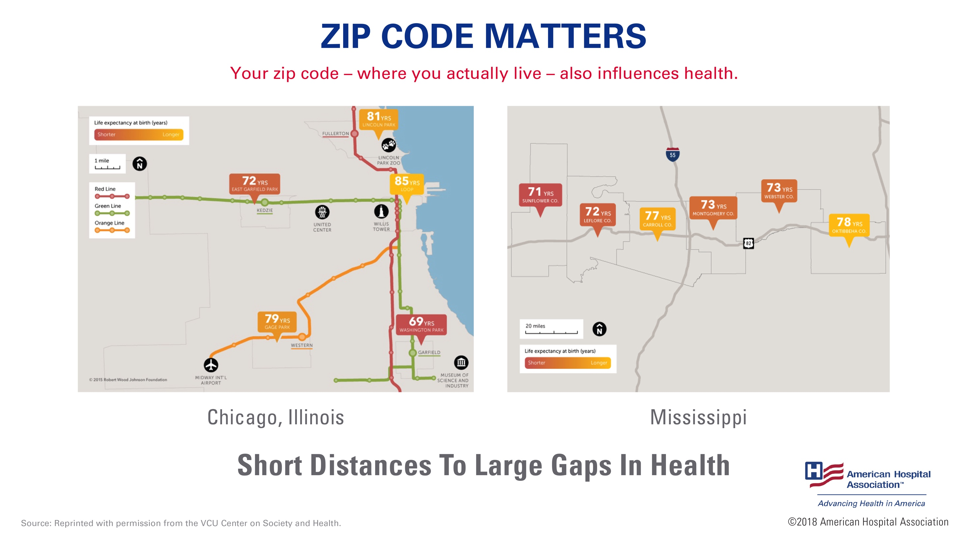
Notes:
Second, your zip code – where you actually live – also influences health.
These maps illustrate the difference in life expectancy we can see in even just a small radius.
In Chicago, babies born within a few stops away on the Chicago Transit Authority’s Green Line can face up to a 16-year difference in life expectancy.
In addition, in counties along Route 82 in Mississippi and Alabama, babies can face up to a seven-year difference in life expectancy.
For more information on how zip code influences health, please visit: https://www.aha.org/news/insights-and-analysis/2018-05-16-your-zip-code-your-health.
Sources: https://societyhealth.vcu.edu/work/the-projects/mapschicago.html
https://societyhealth.vcu.edu/work/the-projects/mapsmississippi.html

Slide 8
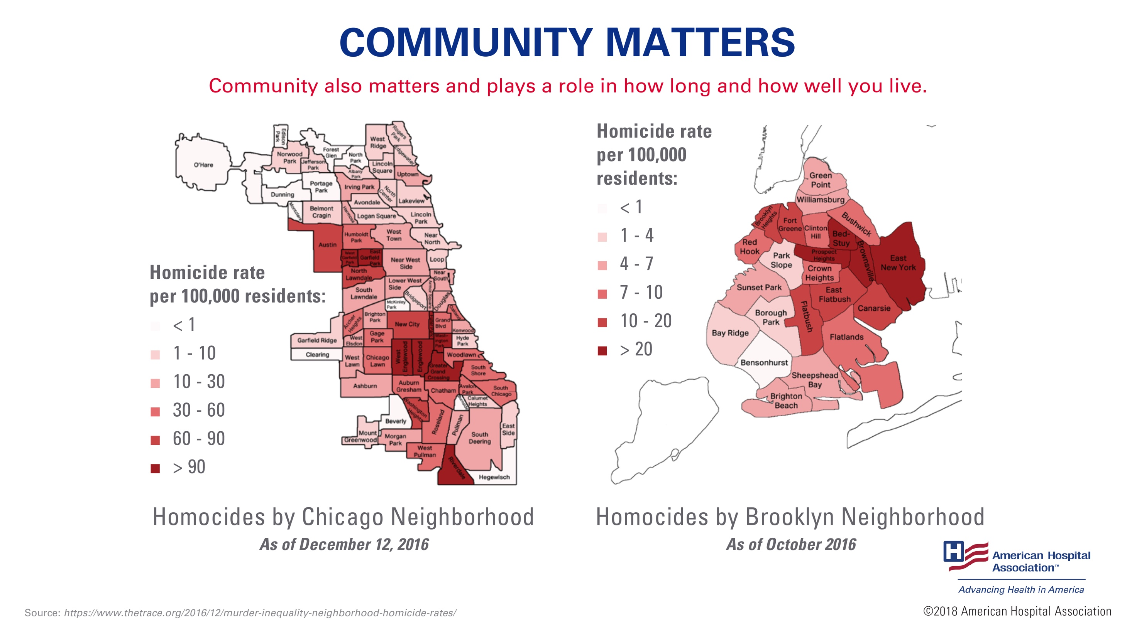
Notes:
Community also matters and plays a role in how long and how well you live.
Some communities and neighborhoods in cities like Chicago and Brooklyn, New York, have higher rates of homicides, while other neighborhoods have lower rates.
Source: https://www.thetrace.org/2016/12/murder-inequality-neighborhood-homicide-rates/

Slide 9
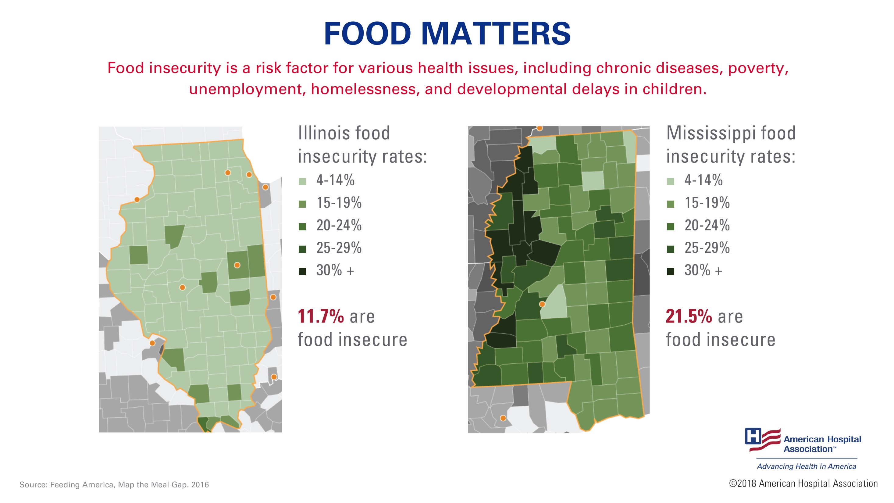
Notes:
Having enough and the right type of food also impacts health. Food insecurity is a risk factor for various health issues, including chronic diseases, poverty, unemployment, homelessness, and developmental delays in children.
The USDA estimates roughly 1 out of 10 households in the U.S. are not sure where their next meal will come from.
Some more specific examples are included on this slide –
In Illinois, 11.7 percent, or 1.5 million people, are food insecure.
While in Mississippi, 21.5 percent, or 643,000 residents are food insecure.
Sources: http://map.feedingamerica.org/county/2015/overall/Illinois
http://map.feedingamerica.org/county/2015/overall/mississippi

Slide 10
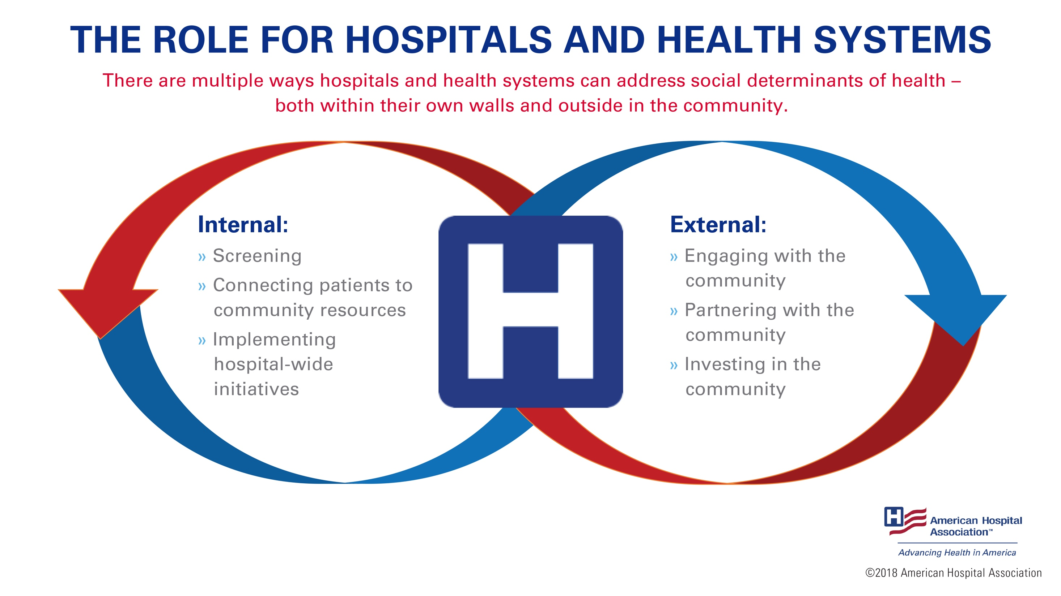
Notes:
It’s important to recognize these differences, and acknowledge that each community has different needs when addressing the social determinants of health.
There are multiple ways hospitals and health systems can address social determinants of health – both within their own walls and outside in the community.
Within their own walls, they can screen patients for socio-economic risk factors and needs, or connect patients and loved ones to community resources.
Knowing that hospitals and health systems alone cannot address all of these issues, external partnerships will be critical. Externally, hospitals and health systems can partner with other stakeholders or make other investments in their communities. This allows hospitals to not only serve as part of the solution, but to work with other stakeholders to better use limited resources to match the needs of their communities.

Slide 11
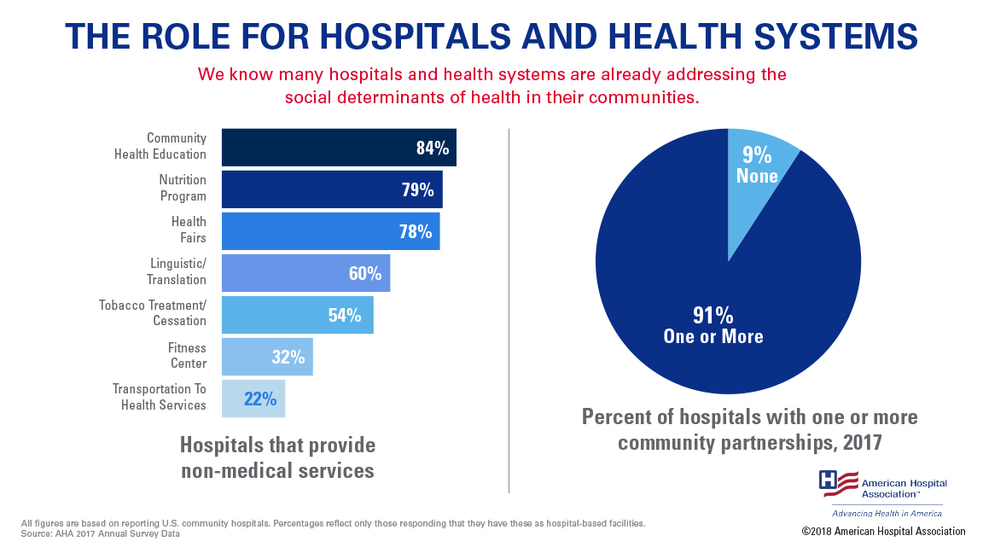
Notes:
We know many hospitals and health systems are already addressing the social determinants of health in their communities.
Recently, Deloitte surveyed 300 hospitals from across the country. They found that 88 percent of respondents are currently screening for social determinants.
And, according to the 2017 AHA Annual survey, once screening has taken place, hospitals are providing non-medical services needed to address those social determinants, including providing transportation and nutrition services. And, many hospitals are working with other stakeholders in the community – in fact, 91 percent of the respondents have entered into at least one type of community partnership to address social determinants. However, there is much more that can be done.
Source: https://www2.deloitte.com/content/dam/Deloitte/us/Documents/life-sciences-health-care/us-lshc-addressing-social-determinants-of-health.pdf

Slide 12
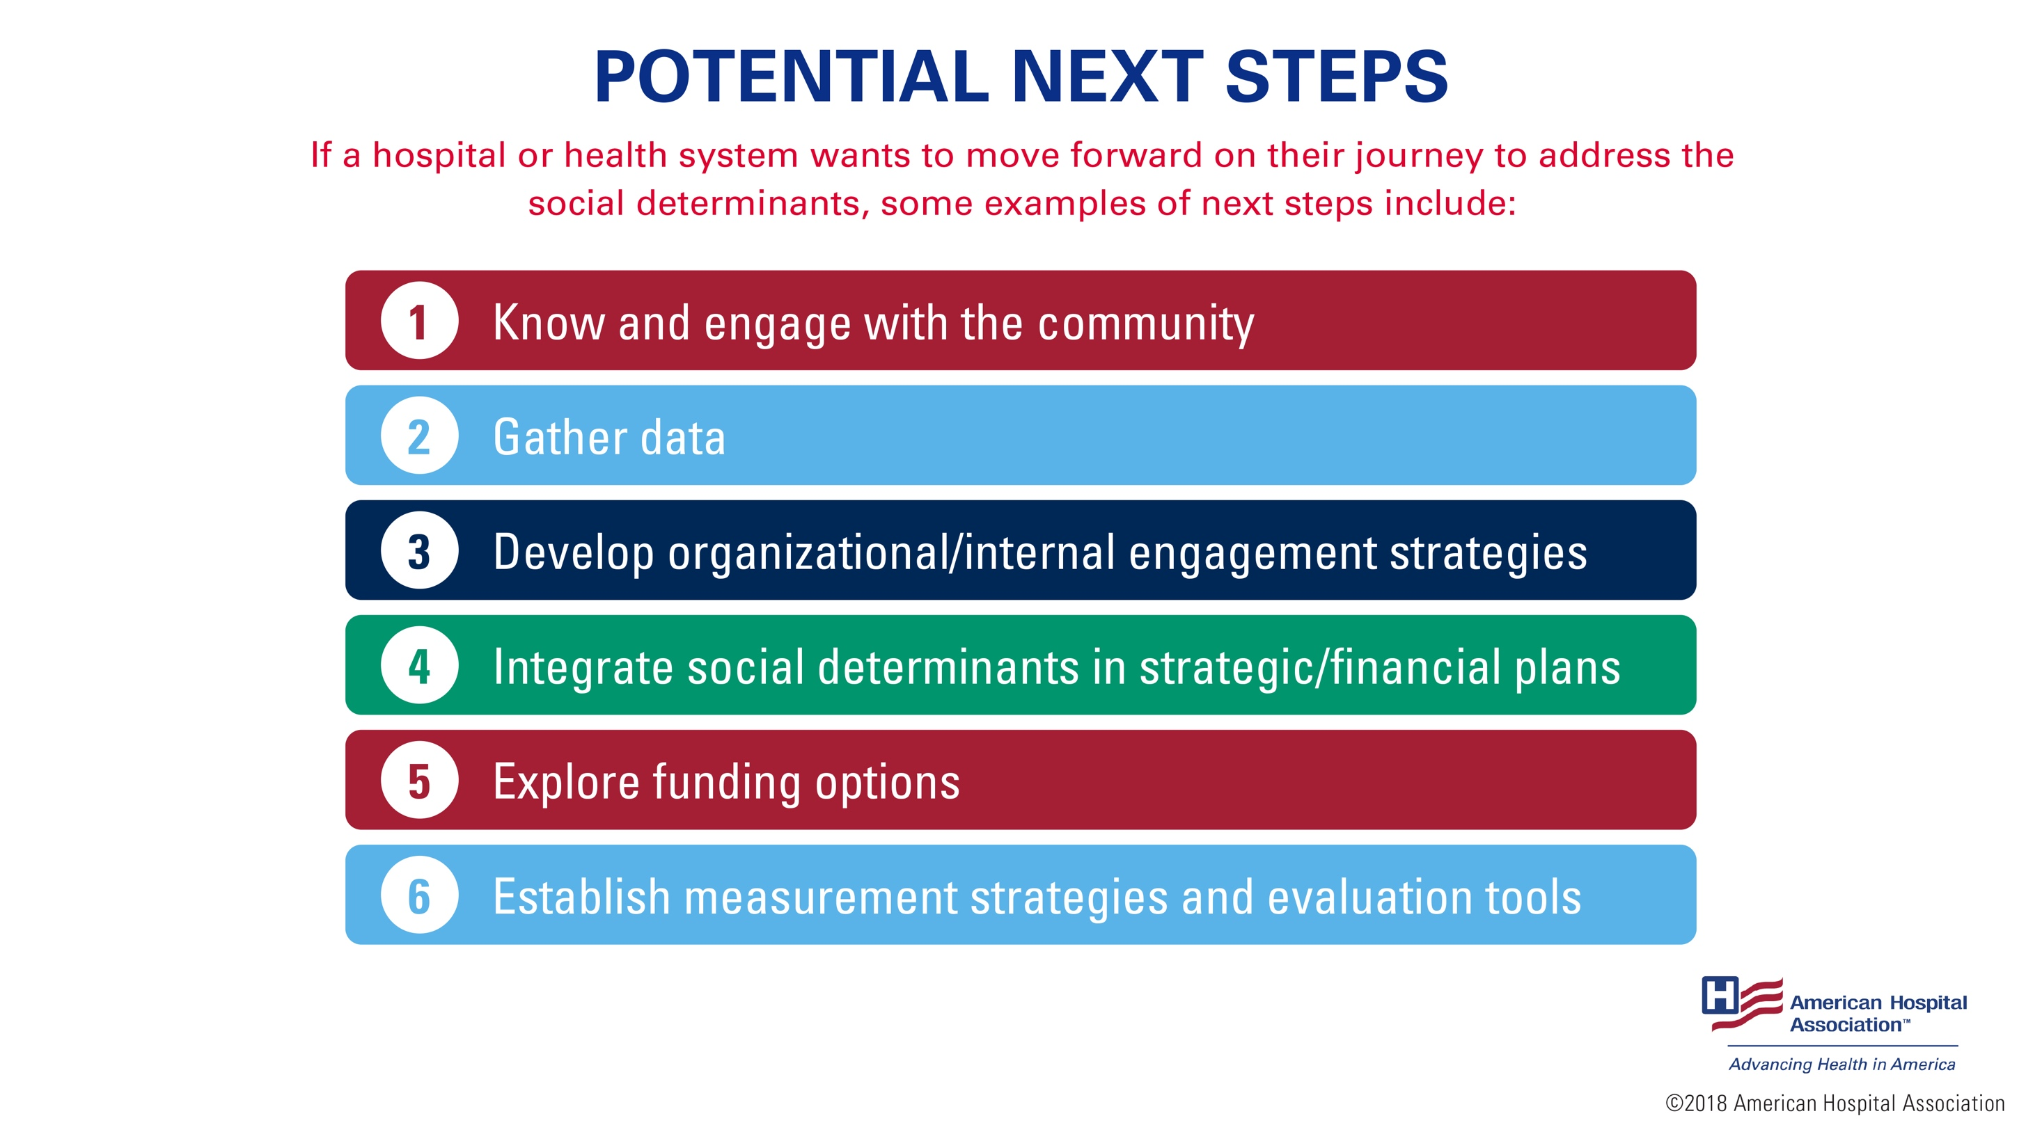
Notes:
If a hospital or health system wants to move forward on their journey to address the social determinants, some examples of next steps include:
Hospitals and health systems can learn about and engage with their community by holding an open forum or community dialogue to discuss the community’s socio-economic health needs.
Hospitals can then gather data on how social determinants of health are affecting their community. That data would then serve as the foundation of any program designed to address those social determinants.
Hospitals can develop internal engagement strategies to support work around social determinants of health. For example, raising awareness about social determinants and sharing the benefits that may be anticipated (i.e., improvements in health, reductions in hospital admissions or utilization rates). Gathering buy-in from leadership and governing boards will be helpful in advancing this work.
Hospitals can also prioritize these efforts by integrating social determinants of health programming into strategic and financial plans.
Many programs hospitals and health systems have adopted to address the social determinants of health are not funded through current payment systems. As a result, hospitals can also explore various funding options and work with community partners to maximize the use of available funds, resources and staff to best serve their communities.
Hospitals may also consider how to measure and evaluate the impact of any social determinants programs they establish. This includes not just data on how many individuals have been served by a particular program, but specific outcome measures that show improvement in the health of individuals and the community.
For help with hosting a community dialogue, visit: https://www.aha.org/system/files/content/17/community-conversations-toolkit.pdf.

Slide 13
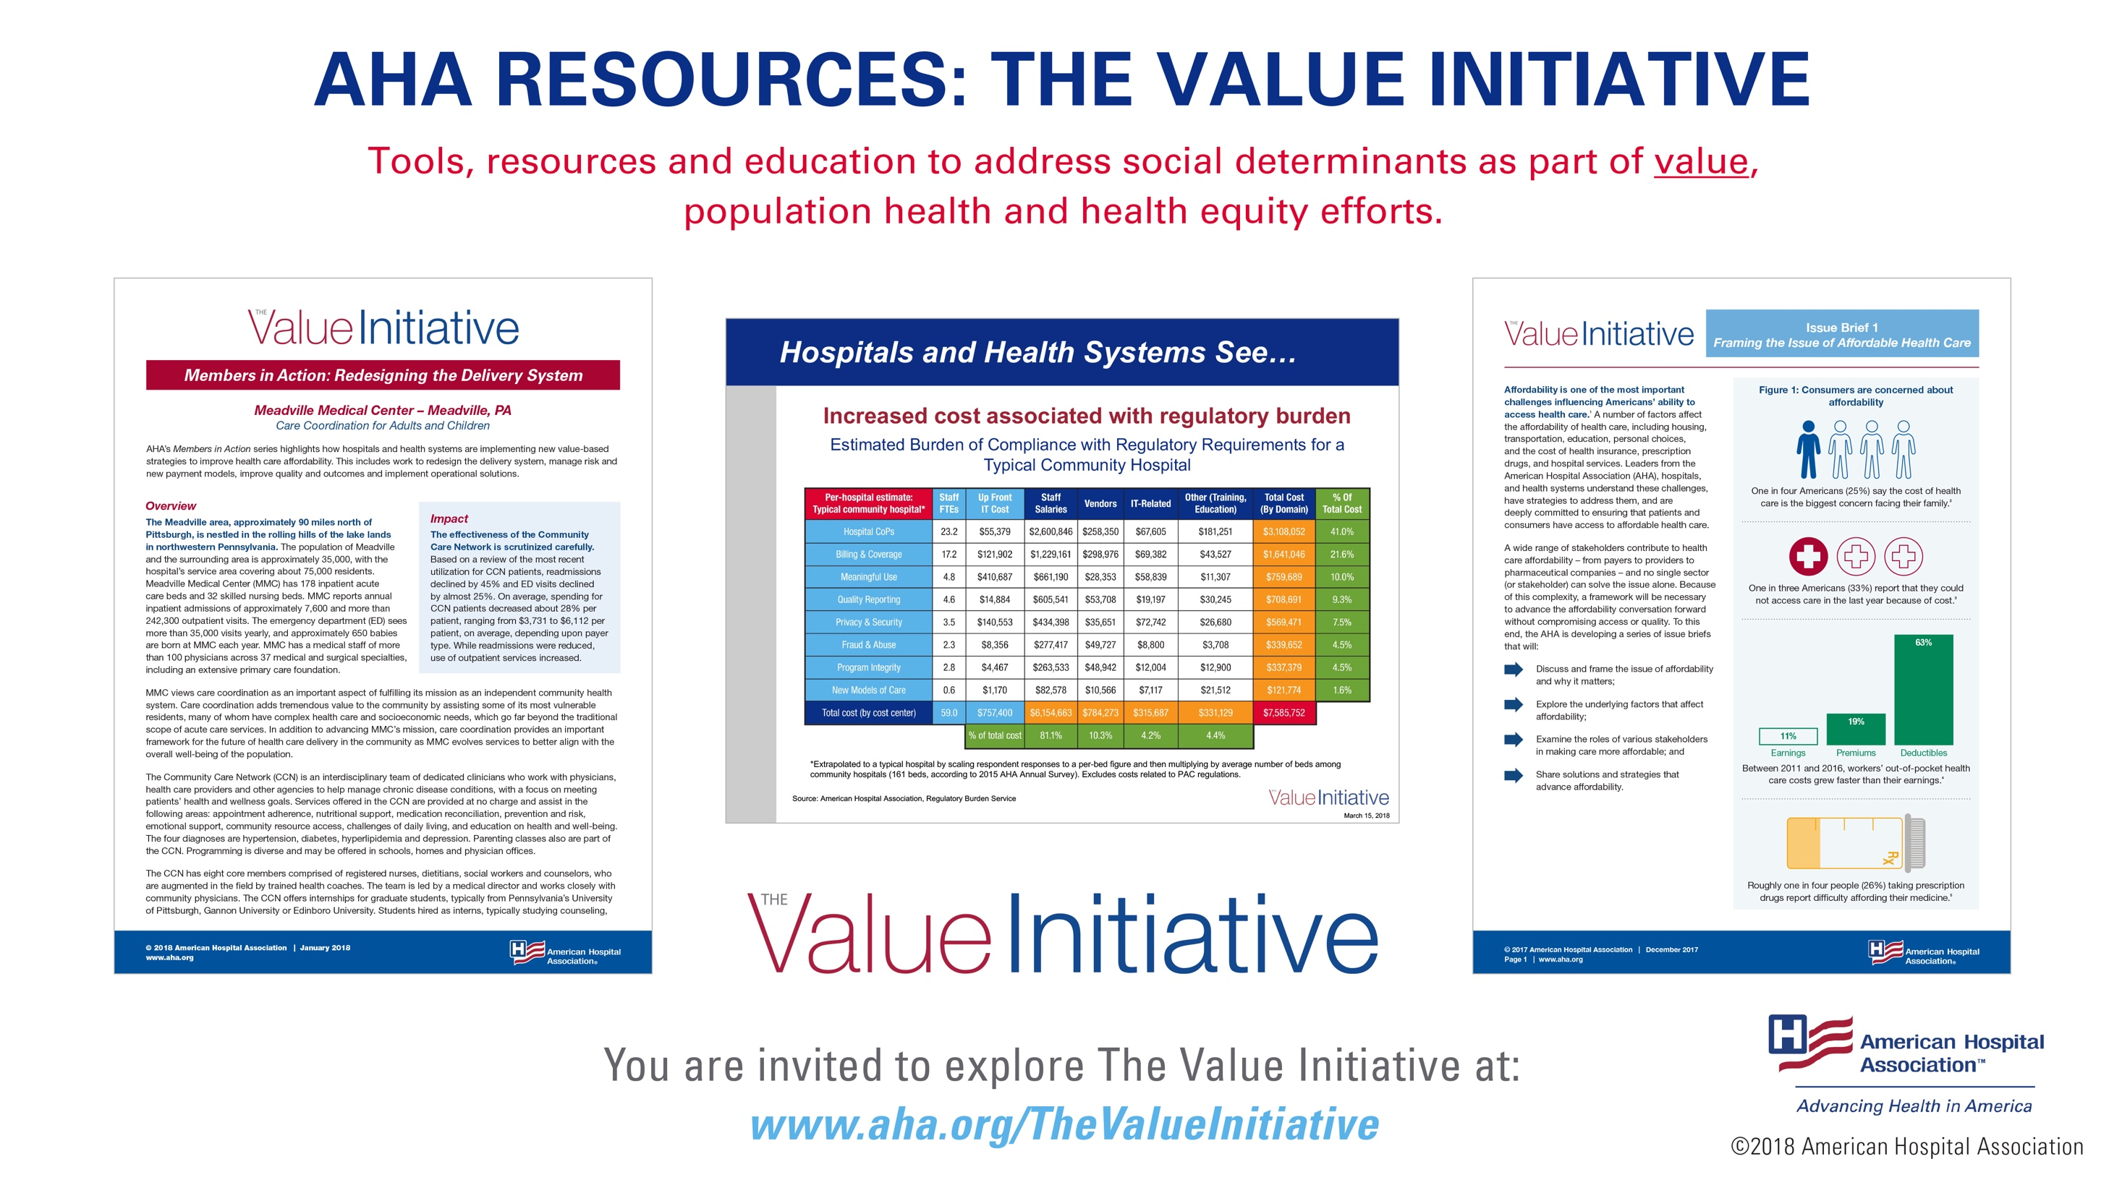
Notes:
AHA is addressing social determinants of health as part of AHA’s larger discussion around value, population health and health equity. We are committed to providing you with the tools, resources and education you need to address this issue in your communities.
Here are some examples.
The Value Initiative - The AHA launched the Value Initiative in December, 2017. It is a member-driven effort to support hospitals and health systems as they tackle the issues of advancing affordable health care and promoting value. Addressing population health and the social determinants of health will be critical to reducing cost and improving the quality of care provided by hospitals and health systems in the future. As a result, AHA has released many resources, including issue briefs, case studies, tools and training, and slide decks on these topics as part of The Value Initiative.
The AHA Members in Action series spotlights a wide-range of approaches hospitals and health systems have taken to address affordability. Many are replicable.

Slide 14
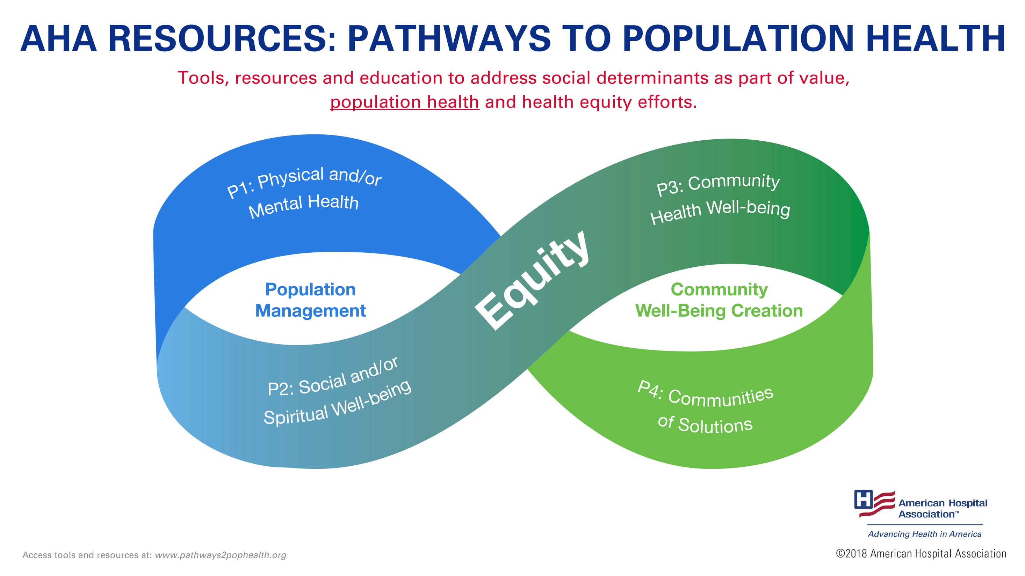
Notes:
AHA, in partnership with other organizations and with funding from the Robert Wood Johnson Foundation, created Pathways to Population Health. This framework supports hospitals, health systems and communities in their efforts on population health and health equity. It focuses on the use of common language, common framework, tools and resources to make practical, meaningful and sustainable advances.
Some strategies to improve health and well-being include: partnering with patients, families and communities to address social determinants; using data-driven strategies; and engaging in performance improvement.
In addition, AHA has released a social determinants of health series to guide hospitals and health systems in addressing social determinants of health in their communities. To date, the reports examine food insecurity, housing and transportation. www.hret.org/sdoh.
Another great resource is the Partnership Playbook and Compendium of Case Studies to help hospitals and communities foster successful and sustainable partnerships.

Slide 15
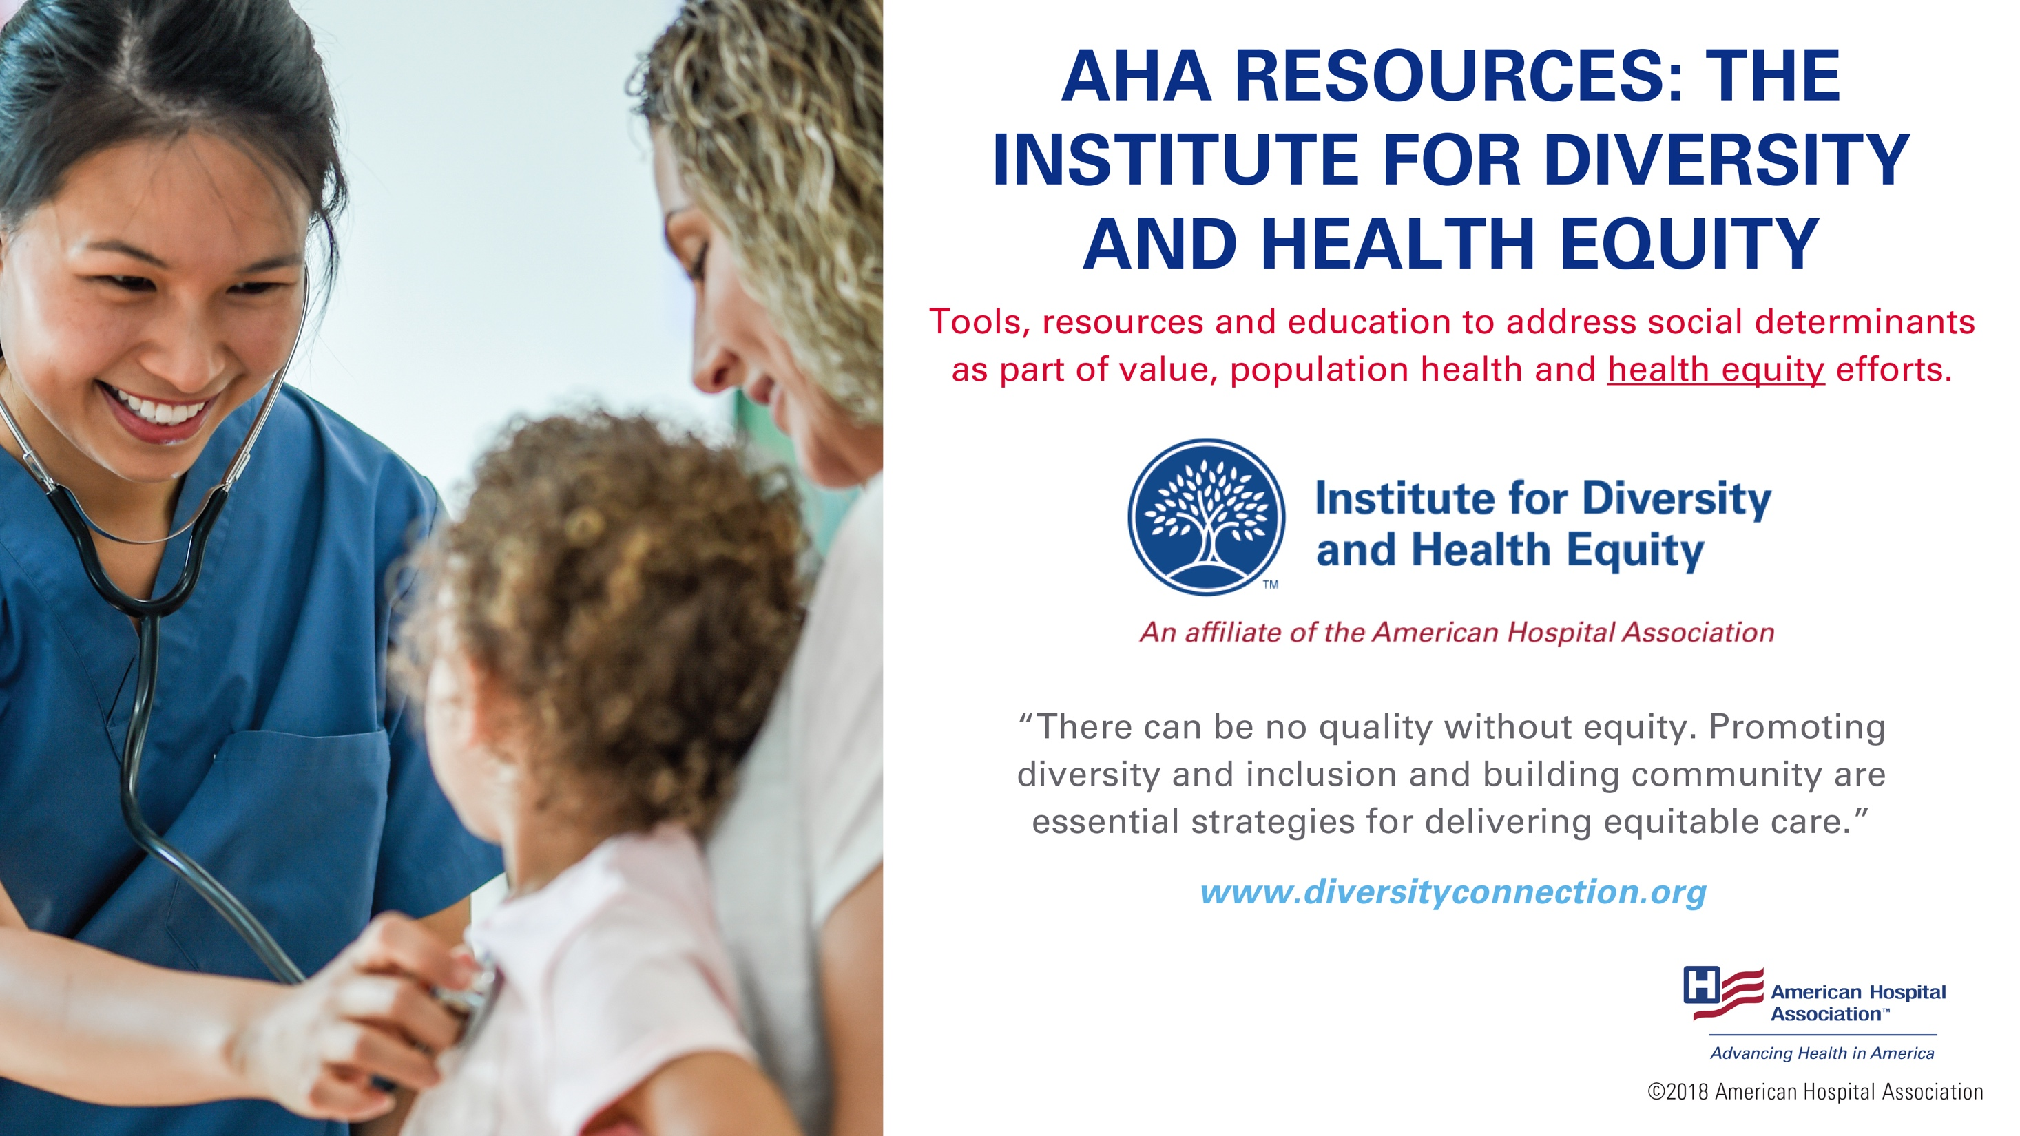
Notes:
Additional resources to address the social determinants are also available through AHA’s Institute for Diversity and Health Equity.
All AHA hospital and health system members are members of the Institute and can access resources to enable equitable care for all individuals and promote inclusive work environments.
The Institute exists to empower health organizations to provide equitable care for all individuals. It provides strategies, resources, and data, as well as a professional network of experts to help health care leaders accelerate and improve their organization’s equity, diversity and inclusion objectives.
Through the Institute, AHA has formed alliances with the National Urban League and UnidosUS (ou-nee-dose-US) to improve the health of African-American and Latino communities across the nation and increase diversity among health care executives shaping the future of care.

Slide 16
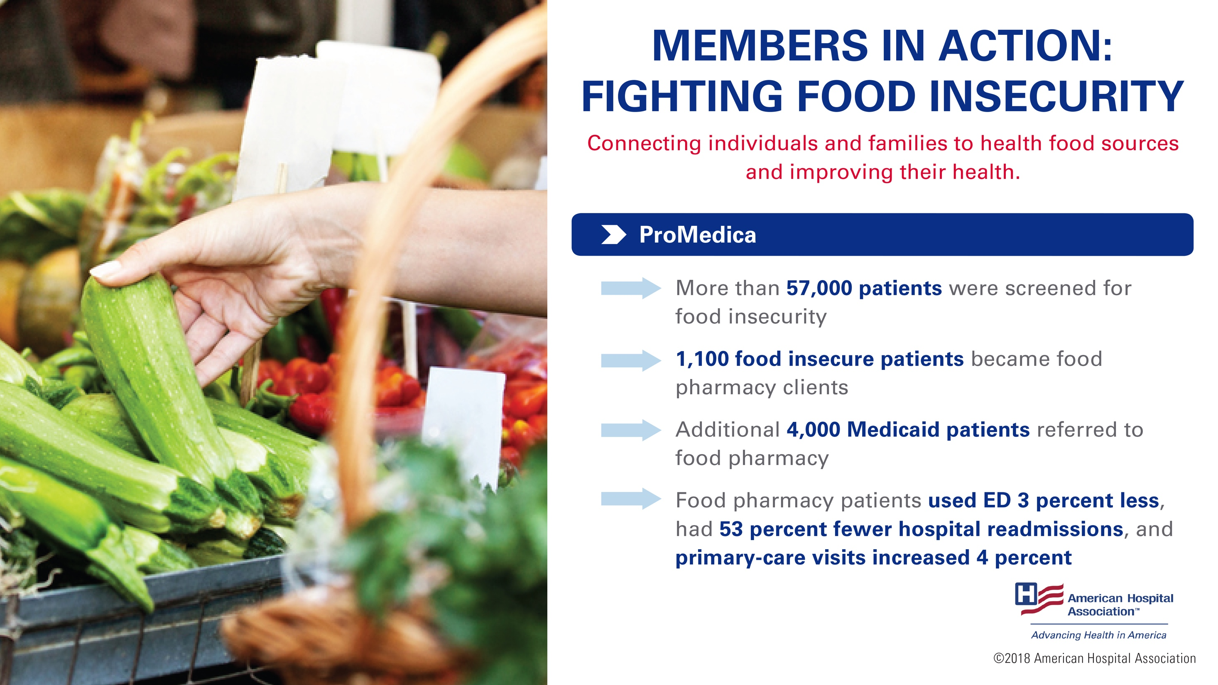
Notes:
Solutions to addressing social determinants of health are community driven and typically developed with specific community needs and resources in mind. I want to share some examples of what’s happening across the country.
ProMedica in Toledo, Ohio, integrated the Children's HealthWatch Hunger Vital SignTM survey into its database. The survey helps identify patients who are food insecure. The survey asks:
Within the past 12 months, we worried whether our food would run out before we got money to buy more.
Within the past 12 months, the food we bought just didn’t last and we didn’t have money to get more.
Staff refer patients with food insecurities to the health system’s food pharmacy.
Source: https://www.aha.org/system/files/hpoe/Reports-HPOE/2017/determinants-health-food-insecurity-role-of-hospitals.pdf

Slide 17
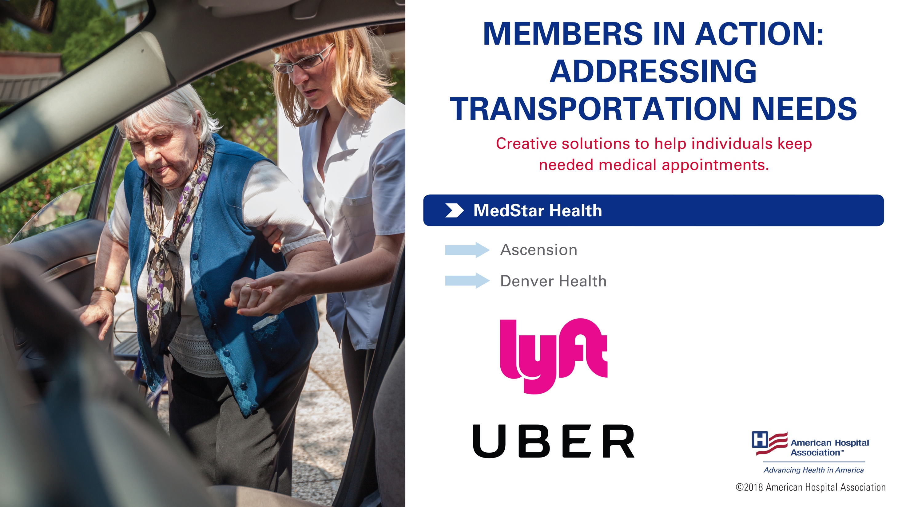
Notes:
Around 3.6 million Americans miss or delay their medical appointments due to lack of transportation.
MedStar Health, the largest health care provider in Maryland and Washington, D.C., partnered with Uber last year, so patients do not miss checkups.
Ascension hospitals and Denver Health partnered with Lyft to make transportation services available to those unable to access health care on time due to lack of transportation.
Sources: https://ascension.org/news/news-articles/2016/12/20/11/05/lyft-partnership
https://www.theatlantic.com/health/archive/2016/08/hospitals-are-partnering-with-uber-to-get-people-to

Slide 18
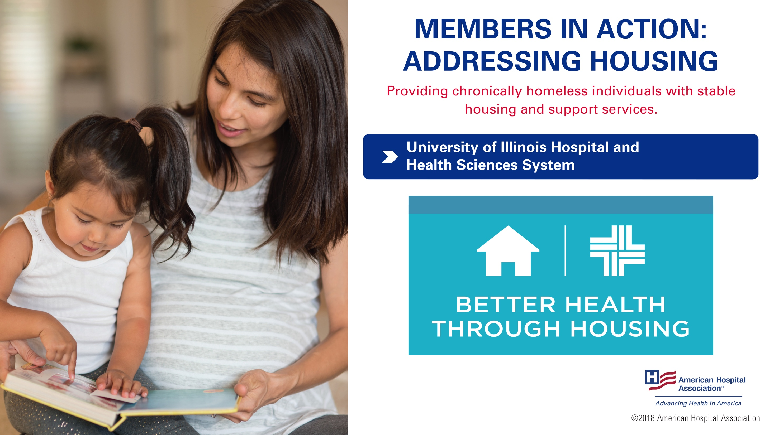
Notes:
University of Illinois Hospital & Health Sciences System in Chicago partnered with the Center for Housing and Health to provide chronically homeless individuals with stable housing and supportive services. The ultimate goal is to help individuals eventually move into fully independent and permanent living situations.
Patients, referred by a health care provider, receive support services, housing units and case management services. In 2015, 26 patients were referred into permanent supportive housing.
Program participants had a 42 percent decrease in overall health care costs – broken down that meant a 21 percent cost reduction for 17 chronically homeless patients and a 67 percent cost reduction for 16 patients after removing one outlier. Additionally, there was a 35 percent reduction in emergency department utilization and an increase in patients accessing clinics for routine care.
Source: https://www.aha.org/system/files/hpoe/Reports-HPOE/2017/housing-role-of-hospitals.pdf

Slide 19

Notes:
Children’s Hospital of Wisconsin collaborated with the Medical College of Wisconsin and the Children’s Service Society of Wisconsin to establish Project Ujima, a violence intervention program that reduces the risk of relapse and increases support to the victims’ families.
The program offers a variety of services, including:
hospital-based crisis intervention and case management for youth victims of violence;
home-based counseling and referrals for medical follow-up and psychological support;
Camp Ujima, a summer day camp for youth exposed to violence;
a leadership development group that does community outreach; and
a grief program for children and families impacted by the loss of a loved one due to community violence.
The process starts with case workers identifying a patient’s needs during hospital stay.
Within two weeks of discharge, a community liaison conducts a home visitation and develops a service plan with the patient. Annually, the project receives an average of 300 referrals, mostly for youths under 18. Services are also offered to a victim’s family, resulting in over 500 service relationships yearly.
Since 2004, the relapse rate has been below one percent. The program also has seen improvements in medical outcomes after injury; school, youth and family relationships; and peer-to-peer connections. Participants have increased their confidence and self-esteem as well.
Source: https://www.aha.org/case-studies/2016-01-01-childrens-hospital-wisconsin-project-ujima

Slide 20
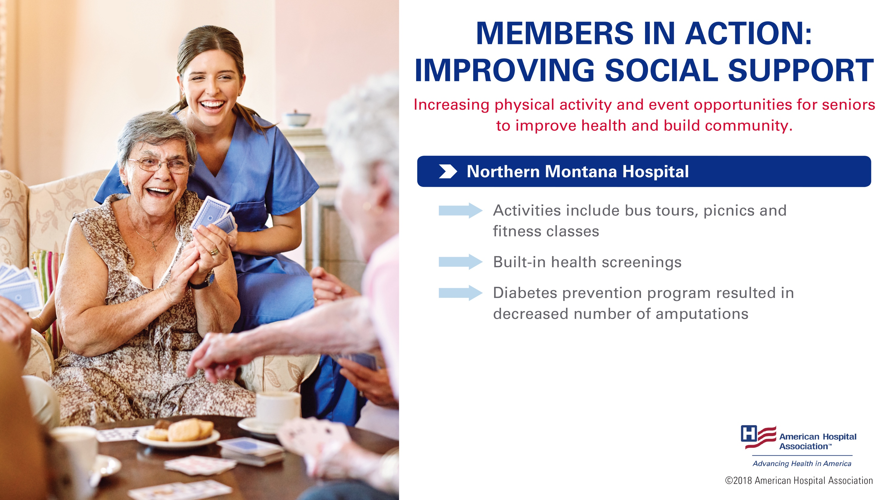
Notes:
Northern Montana Hospital, part of Northern Montana Health Care, is a small, 49-bed, rural hospital, developed Senior Connection, a health promotion outreach program for seniors to promote the physical, social and emotional health and wellness of Northern Montana’s senior population.
Senior Connection provides various services to help support the senior population, including free or discounted health screening, fitness classes, diabetes prevention program, foot care clinics, bus tours, picnics, newsletters, assistance with understanding health care benefits and more.
Ten percent of the 15,000 residents in the community are involved in the Senior Connection program and 250 seniors regularly volunteer.
The program has increased physical activity and enhanced emotional and social support systems through the program’s bus tours, weekend trips, and other outings. It has also increased number of referrals due to health screenings and decreased the number of amputations in diabetic populations due to the diabetes prevention program.
Source: http://www.ahacommunityconnections.org/case-studies/index.dhtml?dcrpath=COMMUNITYCONNECTIONS/cc_case_study/data/output/2013/nmhseniorconnection.dcr

Slide 21

Notes:
Baptist Health and University of Florida Health in Jacksonville, Florida, started Tipping the Scale Adolescent Advocacy and Intervention Mentoring Program almost 20 years ago. The employment program provides at-risk students in Northeast Florida and vulnerable neighborhoods in Jacksonville job training, mentoring, and summer employment.
Students begin the Tipping the Scale program in ninth grade and have weekly training sessions on job interviewing, resume writing, money management, and accountability.
Those who fulfill all training requirements are offered a job at Baptist Health for the summer.
The program began with eight students in 1999 and now has grown to nearly 1,700.
It expanded to a year-round youth mentoring initiative with multiple partners in Duval and Nassau counties. 90 percent of program participants have graduated high school, and almost all have either gone to college, joined military service or acquired a job.
Source: http://www.jacksonville.com/news/metro/2017-07-28/baptist-health-mentoring-work-program-tipping-scales-toward-success-risk-youth

Slide 22
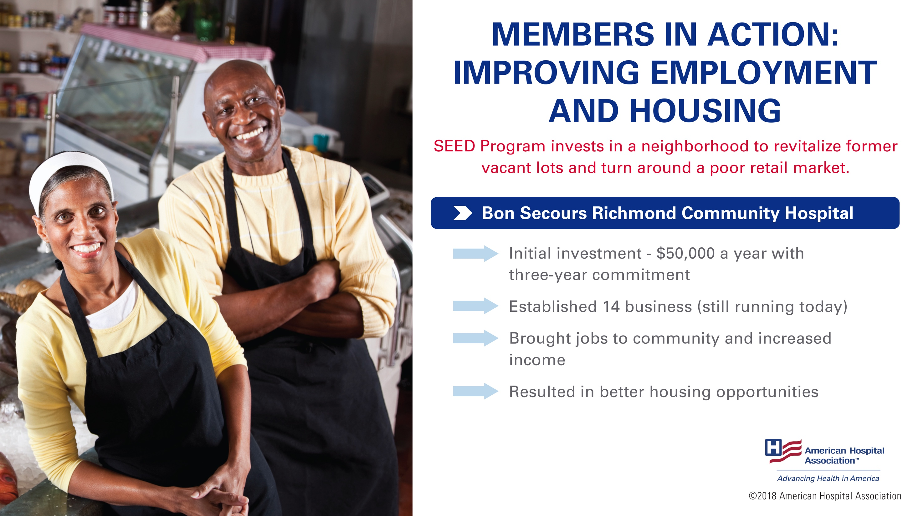
Notes:
Church Hill, a small neighborhood in Richmond, Va., experienced the effects of various social determinants of health, including above average school drop-out rates, large concentrations of public housing, poor public transit, and limited access to jobs. The area’s poverty rate was 69.6 percent with a median family income of $12,947.
Bon Secours Richmond Community Hospital took action addressing the neighborhood’s deterioration, vacant lots, and poor retail market. In collaboration with a bank and the Local Initiatives Support Corporation, the hospital developed the SEED Program—Supporting East End Entrepreneurship Development—as an initiative to revitalize Church Hill through economic development and job creation.
Initially, the hospital invested $50,000 a year with a three-year commitment. The SEED program helped establish 14 businesses in the first three years, which are still operating today.
Since 2011, the program has received $420,000, benefiting 30 East End businesses. These businesses are bringing jobs into the community, and have increased income potential, contributed to better housing opportunities, and provided more stability for residents. USA Today recently named Church Hill one of “10 up-and-coming neighborhood around the USA.”
Source: https://bonsecours.com/richmond/about-us/newsroom/news/2017-seed-grants-totaling-$107000-awarded-to-five-east-end-businesses

