Slide 1
Hospitals and Care Systems
of the Future
2011 AHA Committee on Performance Improvement Report
September 2011
© 2011 American Hospital Association

Slide 2


Hospitals and Care Systems of the Future
Engage senior leadership in planning for the hospital of the future
  Must-do strategies to be adopted by all hospitals
  Second curve metrics measure success of the implemented strategies
  Organizational core competencies that should be mastered
  Self-assessment questions to understand how well the competencies have been achieved
Notes:
Hospitals in Pursuit of Excellence (HPOE) is informed by and also informs the AHA’s advocacy work and our long-term system reform (Health for Life).
HPOE is one of our 3 legs for AHA as it relates to our overall mission.

Slide 3
Driving the Change
Environmental forces will drive the transformation of health care delivery and financing over the next decade, demanding hospital and health system change
Demographics
Overall increased health care spending
Shift to value-based reimbursement
Provider accountability for cost and quality of care
Care fragmentation
Transparency of cost, quality, and community benefit data
Projected provider shortages
High-cost advances in medical technology and pharmaceuticals
Difficulty in raising capital
Federal and state reform and legislation
Reimbursement decline
Challenges to care variations
Notes:
HPOE is the AHA strategy for accelerating performance improvement.
HPOE started by initially focusing on 4 topics: (preventing infections, harm, medication safety and patient flow).
In the last few months HPOE added 2 more topics: care coordination and implementing HIT.
The next topic for HPOE is improving efficiency.

Slide 4
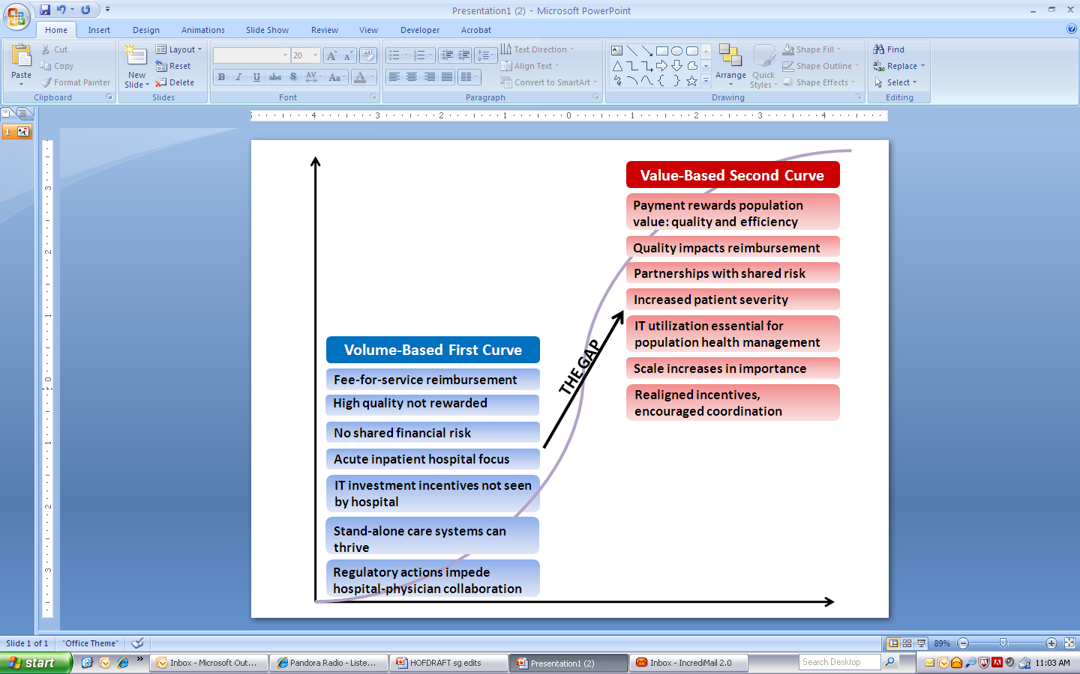
First-Curve to Second-Curve Markets
How will hospitals successfully navigate the shift from first-curve to second-curve economics?
Notes:
HPOE is the AHA strategy for accelerating performance improvement.
HPOE started by initially focusing on 4 topics: (preventing infections, harm, medication safety and patient flow).
In the last few months HPOE added 2 more topics: care coordination and implementing HIT.
The next topic for HPOE is improving efficiency.

Slide 5
Overall Approach
Conducted telephone and in-person interviews with senior leaders from hospitals and stakeholders.
Synthesized results into succinct list of actionable strategies that lead to more qualitative organizational core competencies
Strategies and core competencies prioritized through survey of Regional Policy Boards
Results reviewed and approved by AHA Committee on Performance Improvement and AHA Board.

Slide 6
Strategy Implementation Leads to Core
Competency Development
Adoption of Must-Do
Strategies
Development of Core Competencies
  Clinician-hospital alignment
  Quality and patient safety
  Efficiency through productivity and financial management
  Integrated information systems
  Integrated provider networks
  Engaged employees & physicians
  Strengthening finances
  Payer-provider partnerships
  Scenario-based planning
  Population health improvement
Organizational culture enables strategy execution
  Design and implementation of patient-centered, integrated care
  Creation of accountable governance & leadership
  Strategic planning in an unstable environment
  Internal & external collaboration
  Financial stewardship and enterprise risk management
  Engagement of employees’ full potential
  Utilization of electronic data for performance improvement
Metrics to Evaluate Progress
Self-Assessment Questions

Slide 7
Actionable Strategies
Ten Must-Do Strategies were Identified for Hospital Implementation
Aligning hospitals and providers across the care continuum
Utilizing evidence-based practice to improve quality & patient safety
Improving efficiency through productivity & financial management
Developing integrated information systems
Joining and growing integrated provider networks and care systems
Educating and engaging employees and physicians
Strengthening finances to facilitate reinvestment and innovation
Partnering with payers
Advancing your organization through scenario-based strategic, financial and operational planning
Seeking population health improvement through pursuit of the “triple aim”
Notes:
HPOE is the AHA strategy for accelerating performance improvement.
HPOE started by initially focusing on 4 topics: (preventing infections, harm, medication safety and patient flow).
In the last few months HPOE added 2 more topics: care coordination and implementing HIT.
The next topic for HPOE is improving efficiency.

Slide 8
Use Second-Curve Metrics to Measure Success in Alignment
Aligning Hospitals, Physicians and other Providers Across the Care Continuum
Number of aligned and engaged physicians
Percentage of physician and provider contracts with quality and efficiency incentives
Availability of nonacute services
Distribution of shared savings/gains to aligned clinicians
Number of accountable covered lives
Number of providers in leadership
Second-Curve Metrics
Number of physicians on staff
Financial profit and loss from employed physicians
Hospitalist utilization
Number of contracts for non- acute services
First-Curve Metrics

Slide 9
Use Second-Curve Metrics to Measure Success in Evidence-Based Practices
Utilizing Evidence-Based Practices to Improve Quality
Effective measurement and management of care transitions
Management of utilization variation
Changes in preventable admissions, readmissions, ED visits, and mortality
Reliable patient care processes
Active patient engagement in design and improvement
Second-Curve Metrics
CMS core measures for process quality
Patient satisfaction and overall experience
Facility type-specific quality and safety measures
30 day readmission rates
First-Curve Metrics

Slide 10
Use Second-Curve Metrics to Measure Success in Efficiency
Improving Efficiency through Productivity and Financial Management
Expense per episode of care
Shared savings or financial gains from performance-based contracts
Targeted cost reduction goals
Management to Medicare margin
Second-Curve Metrics
Staffing ratios
Cost per inpatient stay (med/surg)
Operating margin
Length of stay
First-Curve Metrics

Slide 11
Use Second-Curve Metrics to Measure Success in Integrated IT
Developing Integrated Information Systems
Integrated data warehouse
Lag time between analysis and availability of results
Understanding of population disease patterns
Use of health information across care continuum and community
Real-time information exchange
Active use of patient health records
Second-Curve Metrics
Number of health information technology systems implemented
Data extracted
Information exchange across providers
First-Curve Metrics

Slide 12
Strategic Progress at Our Organization
Priority Strategy |  | OUR HOSPITAL’S Actions
Aligning hospitals, physicians, and other providers across the care continuum |  | Enter actions taken by your organization to reach this strategy
Utilizing evidence-based practices to improve quality and patient safety |  | Enter actions taken by your organization to reach this strategy

Slide 13
Strategic Progress at Our Organization
Priority Strategy |  | OUR HOSPITAL’S Actions
Improving efficiency through productivity and financial management |  | Enter actions taken by your organization to reach this strategy
Developing integrated information systems |  | Enter actions taken by your organization to reach this strategy

Slide 14
Core Competency: Care Models
Designing and Implementing Patient-Centered, Clinically Integrated Models of Care
Assessment /Discussion Questions
Have we developed a clear and compelling approach to clinician alignment and integration for our marketplace?
Are we developing sufficient capabilities to measure, manage, and improve the quality and efficiency of patient care across the continuum of care?
How are we assimilating best practices into clinical medicine?
Can we play a role in improving overall population health?

Slide 15
Core Competency: Leadership
Creating Accountable Governance & Leadership
Assessment /Discussion Questions
Does the board understand the strategy to move toward the second curve? Can they assess the unique balance of risks and rewards?
Has the board streamlined its structure and responsibilities to reflect the vision of an integrated, accountable system?
Does the board have an explicit succession planning process in place select and develop leaders with the right attributes?
Does physician engagement in governance and management reflect their emerging roles as economic and clinical partners?
Is there increased transparency through communication of outcome, financial, and community- benefit data both internally and externally?

Slide 16
Core Competency: Strategic Planning
Strategic Planning in an Unstable Environment
Assessment /Discussion Questions
Do we have a clear, compelling vision for the second curve?
How quickly should we move toward value-based care delivery, when financial incentives still favor volume?
What is the necessary mix of inpatient beds, ambulatory facilities, providers, and technology to meet future demand?
What scale of our organization is sustainable in the future?
Should our organization explore new strategic partnerships? What partner meets our needs while matching our mission?
Are we utilizing scenario-based planning techniques to monitor key changes and making adjustments?
Do we assess the health needs of our community? Do we work with partners to improve access?
Have we examined our mission to determine if we can financially sustain high quality in all of our services?

Slide 17
Core Competency: Collaboration
Facilitating internal and external collaboration
Assessment /Discussion Questions
How well are we developing trust within our organization?
What is our desired culture?
Are our leaders “role models” for a collaborative culture?
Are we considered a valuable partner to physicians and other organizations within the community?
Do we know our partners well enough? Do they trust us?

Slide 18
Core Competency: Financing
Exercising Financial Stewardship and Enterprise Risk Management
Assessment /Discussion Questions
How aggressively should we invest in strategic capabilities for which short-term returns are uncertain, such as physician alignment, payment pilot projects, population health management, and evidence-based medicine?
Can we measure revenues and expenses by each clinical service?
Are we utilizing an annual enterprise risk management assessment?
Have we identified long-term financial goals and a plan to get there?

Slide 19
Core Competency: Employee Engagement
Engaging Full Employee Potential
Assessment /Discussion Questions
What is our strategy for employee and physician partner engagement?
Are our employee and physician recruitment and retention systems aligned with our strategic direction and desired culture?
Are we a learning organization? How are we developing the knowledge and skills of physicians, middle managers, employees, and senior executives?

Slide 20
Core Competency: Data Utilization
Collecting and Utilizing Electronic Data for Performance Improvement
Assessment /Discussion Questions
When will our information systems bring all pertinent information to the point of care?
How far along are we in achieving digital connectivity among providers and with patients?
How often is the data collected from information systems reviewed at clinical and administrative team meetings? What data is brought to senior leadership’s attention?

Slide 21
Hospitals and Care Systems of the Future and Select Additional HPOE Resources
AHA Research Synthesis Report: Bundled Payment
AHA Research Synthesis Report: Accountable Care Organizations
AHA Research Synthesis Report: Patient-Centered Medical Home
A Health Care Leader Action Guide to Reduce Avoidable Readmissions
A Health Care Leader Action Guide: Understanding and Managing Variation
Early Learnings from the Bundled Payment Acute Care Episode Demonstration Project
Striving for Top Box: Hospitals Increasing Quality and Efficiency
Competency-Based Governance: A Foundation for Board and Organizational Effectiveness
A Guide to Achieving High Performance in Multi-Hospital Health Systems
Using Workforce Practices to Drive Quality Improvement: A Guide for Hospitals
A Guide to Financing Strategies for Hospitals – With Special Consideration for Smaller Hospitals
www.hpoe.org
© 2011 American Hospital Association
Notes:
Hospitals in Pursuit of Excellence (HPOE) is informed by and also informs the AHA’s advocacy work and our long-term system reform (Health for Life).
HPOE is one of our 3 legs for AHA as it relates to our overall mission.

