Slide 1

RACTrac Enhancements:
A Discussion with the RACTrac-Compatible Vendor Community
Elizabeth Baskett, Senior Associate Director, Policy, AHA
Katie Christensen, PCS, AHA RACTrac Contractor
April 20, 2011

Slide 2
Agenda
Thanks for Making RACTrac a Success!!
RACTrac-Compatible Vendor Resources
RACTrac Enhancements
RACTrac Enhancements Release Management and Testing
Questions and Answers
2

Slide 3
THANKS for Making RACTrac a Success!!!!
As January of 2011, there were 1850 hospitals participating in RACTrac (up from 1667 last quarter)

Slide 4
RACTrac-Compatible Vendor Resources

Slide 5
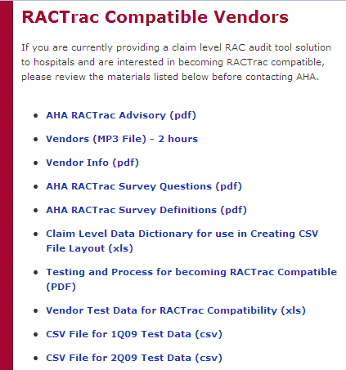
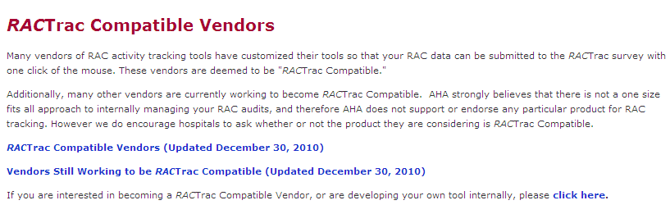
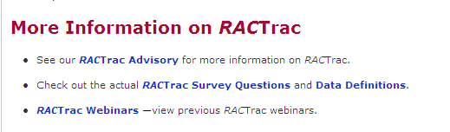
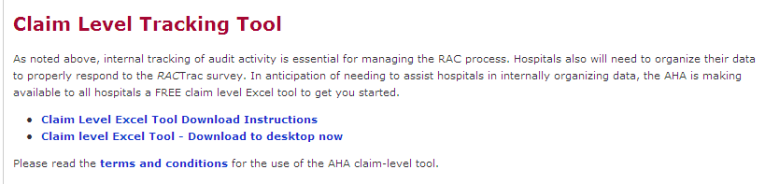
AHA RAC & RACTrac Resources
AHA RACTrac Resources
  http://www.aha.org/aha/issues/RAC/ractrac.html
    Survey Questions
    Data Definitions
    Previous Webinars
    AHA claim level tool
    Vendor Product Descriptions

Slide 6
RACTrac Enhancements

Slide 7
2011 RACTrac Enhancements
The AHA recently implemented enhancements to RACTrac to collect additional information on the impact of RACs on hospitals
Enhancements were made at the request of hospitals, Allied hospital associations and RACTrac-compatible vendors
Enhancements are effective April 1, 2011
AHA will work with RACTrac-compatible vendors to incorporate new data elements into CSV files
State and metro hospital associations will be able to access state-level data for each of the enhancements
7

Slide 8
RACTrac Quality Assurance Procedures
(currently optional)

Slide 9
Quality Assurance Procedures (currently optional!)
Automated Information
  If the number of automated denials is 0, then the value of automated denials and value of automated recoupment must also be 0.
  Value of automated recoupment cannot be greater than the value of automated denials
  If the number of automated denials >0 then the value of automated denials must also be > 0
9

Slide 10
Quality Assurance Procedures (currently optional!)
Complex Information
  If the number of complex medical record requests is 0, then the number of approvals, denials, and pending must all be 0 as well.
  The number of medical record requests should equal the sum of approvals + denials+ pending
  The dollars associated with medical record requests should equal the dollars associated with approvals + denials + pending.
10

Slide 11
Quality Assurance Procedures (currently optional!)
Complex Information
  Complex recouped dollar cannot be larger than the dollars associated with medical record requests
  Complex recouped dollar must be less than or equal to the dollars associated with overpayments
  Complex recouped dollar cannot be larger than the dollars associated with overpayments
  Complex overpayment dollar cannot be larger than the dollars associated with medical record requests
11

Slide 12
Quality Assurance Procedures (currently optional!)
Underpayment Information
  If the number of underpayments is 0, then dollars associated with underpayments and underpayments returned to the facility must also be 0.
  Dollars returned to the facility must be less than or equal to the dollars associated with underpayments
  If the number of underpayments is greater than 0, the dollars associated with underpayments must also be greater than 0
12

Slide 13
Quality Assurance Procedures (currently optional!)
Appeal Information
  The sum of appeals filed must equal the sum of appeals in progress + appeals withdrawn + appeals overturned.
  The dollars associated with appeals filed must also equal the sum of appeals in progress + appeals withdrawn + appeals overturned.
13

Slide 14
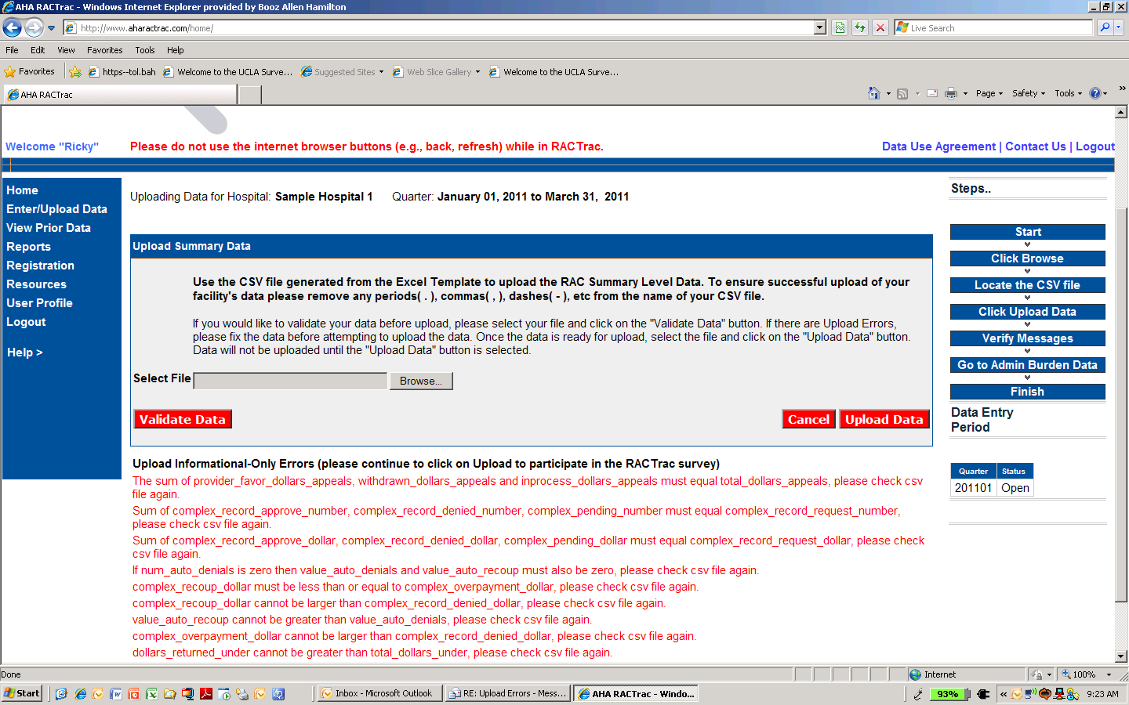
Quality Assurance Procedures (currently optional!)
What does the user experience?
Optional. Does not submit data.
Provides information-only message.
For now, submits RACTrac data without quality assurance validation.
14

Slide 15
Quality Assurance Procedures (currently optional!)
Frequently asked questions …
  Informational messages are cumulative. All quality assurance violations are communicated at that point in time.
  This message does not prevent the user from successfully submitting their data. (see the UPLOAD button)
  This message does not inherently impact the quality of RACTrac reporting. (quality assurance processes are built into the reporting procedure)
  These processes are not intended to capture all potential issues and/or assure the quality of submitted data.
15

Slide 16
RACTrac Survey Changes

Slide 17
2011 RACTrac Enhancements
RACTrac is now collecting data on:
Incorrect MS-DRG denials
  Top three DRG codes denied
Medical necessity review (MNR) denials
  Number and dollar amount of total MNR denials
  Number and dollar amount of MNR denials for inappropriate setting
  Top three DRG codes denied
Incorrect Discharge Disposition is both a reason for Complex Overpayment and a reason to Appeal
Cost of the appeals process
17

Slide 18
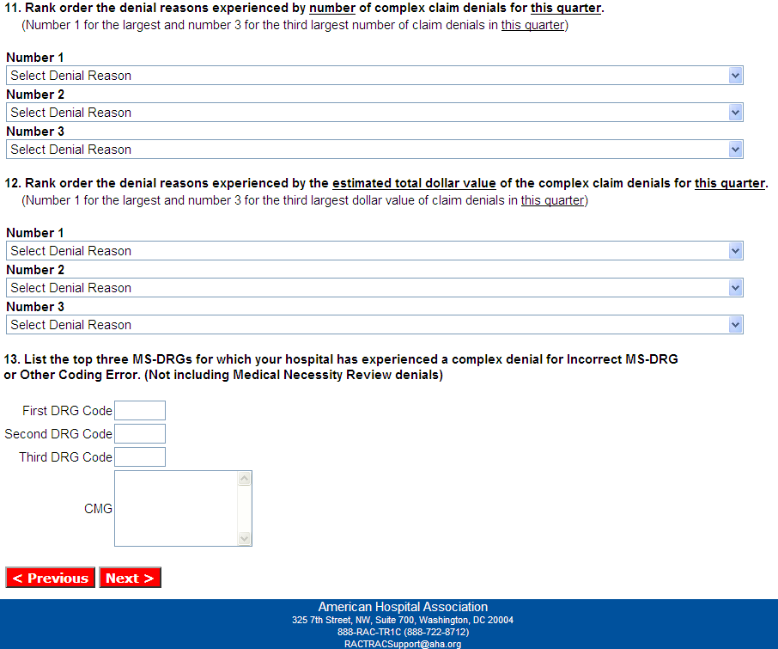
2011 RACTrac Enhancements: Incorrect MS-DRG Denials
18

Slide 19
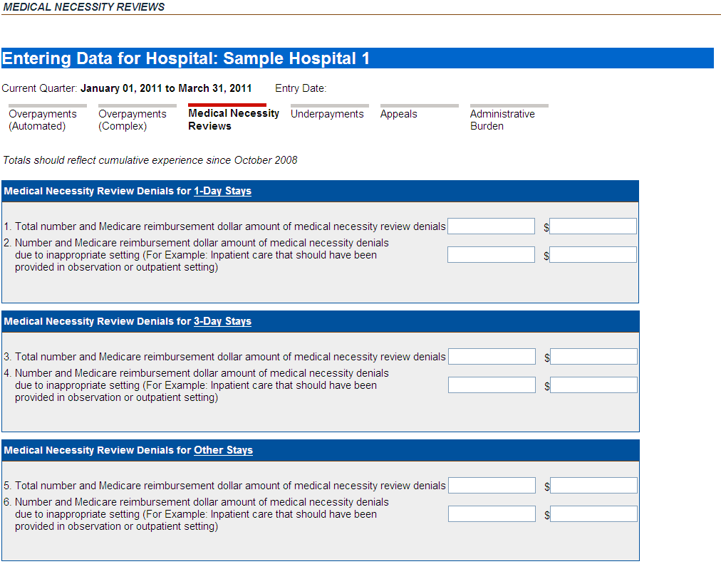

2011 RACTrac Enhancements: Medical Necessity Review
19

Slide 20
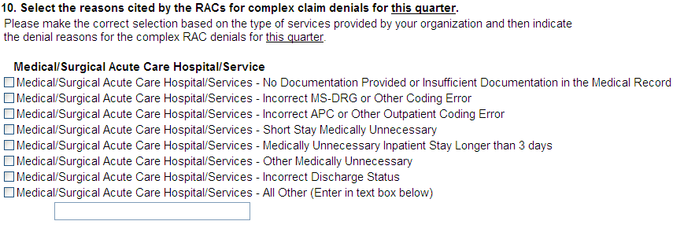
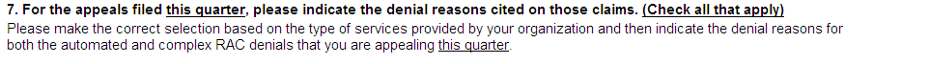
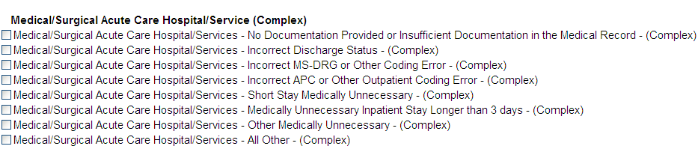
2011 RACTrac Enhancements: Incorrect Discharge Status
Complex
Appeals
20

Slide 21
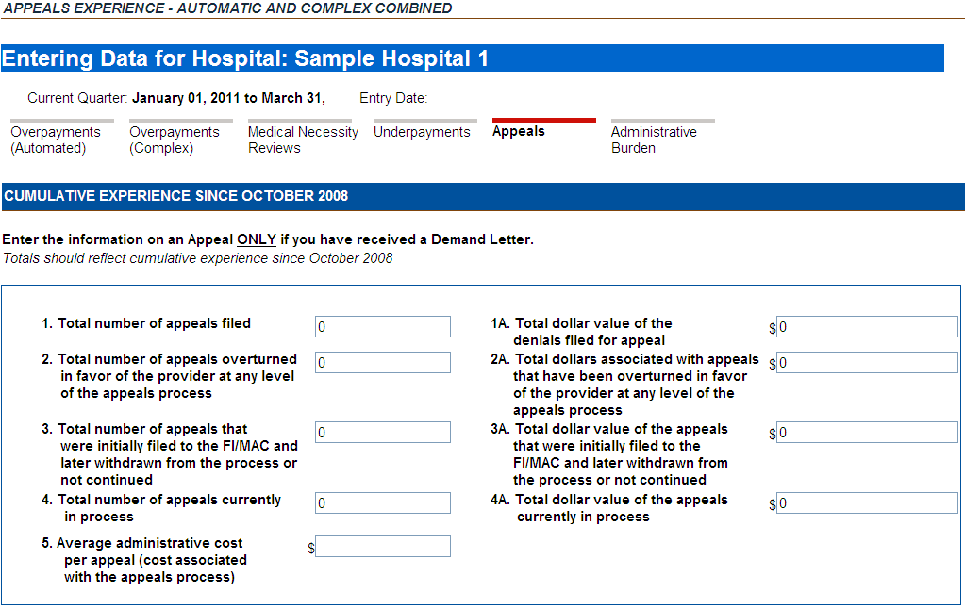
2011 RACTrac Enhancements: Cost of Appeals
21

Slide 22
RACTrac Survey Changes
Release Management & Testing

Slide 23
Release Management & Testing
Old CSV files that do not contain the RACTrac enhancements can still be uploaded into the survey
AHA is asking RACTrac-compatible vendors to incorporate changes into their software to reflect the wishes of the vendor, hospital and association communities who requested the changes
AHA requests that the CSV files be updated and distributed to hospitals for use in the next data collection period in July 2011
  Incorporating quality assurance checks as well as new survey questions
23

Slide 24
Getting Started
Survey questions available online
Survey definitions also available online
Identification of new, changed data elements and related criteria
Identified of quality assurance procedures
Data Specifications not yet finalized
  Planned for late April release
24

Slide 25
What you can and can’t do at this point …
Can program quality assurance tests into data set prior to creating the CSV file
Add discharge status as an available option (and map appropriately) for the reason for an overpayment, and reason for appeal
Capture top 3 MS-DRGs for both Medical Necessity and Complex Overpayment
Segregate medical necessity denials
  Volume and dollar amount from the demand letter by LOS
25

Slide 26
Testing
AHA does not foresee exhaustive testing comparable to the first CSV file testing process
AHA does foresee a ‘quick’ iteration whereby the CSV will be verified by PCS to be compatible with layout standards and contains reasonable values
Please advise as to your release management timeframes so we know what to expect from a support perspective
26

Slide 27
Questions and Answers
For more information on:
RACTrac
Tracking RAC activity with AHA’s Free Claim Level Tool
Previous RACTrac Webinars www.aha.org/aha/issues/RAC/ractrac.html

