Slide 1


Physician Payment After SGR Reform:
An Overview
© American Hospital Association
Notes:
1

Slide 2
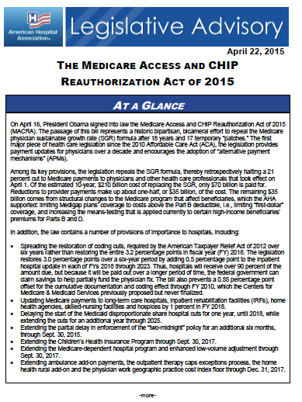
Agenda
Policy context
Overview of MACRA provisions
Potential implications for hospitals and health systems
Regulatory Activity

Slide 3
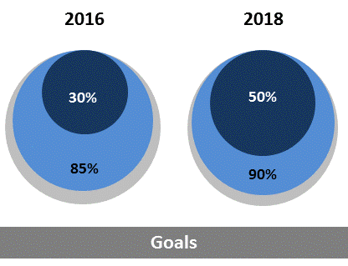
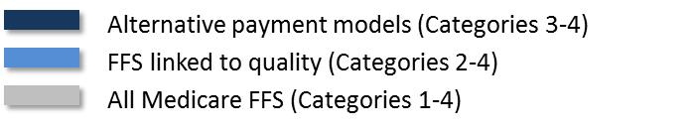
Doubling Down on “Volume to Value”
Triple Aim:
  Better Care
  Smarter Spending
  Healthier People
HHS moving from
volume to value
  Pay-for-performance
  initiatives
  Alternative
  payment models
Target percentage of payments in ‘FFS linked to quality’ and ‘alternative payment models’ by 2016 and 2018
Notes:
As you well know, the hospital and health care field is currently undergoing major changes. There are many initiatives designed to push the health care field in this direction and hospitals are currently part of many pay for reporting and pay for performance initiatives as well as alternative payment models, including bundled payment programs.
Last January, Secretary Burwell announced HHS’s goals and timeline for moving the Medicare program toward paying for value, rather than volume. Specifically, HHS set a goal of tying 30 percent of traditional, or fee-for-service, Medicare payments to quality or value through alternative payment models by the end of 2016, and tying 50 percent of payments to these models by the end of 2018. HHS also set a goal of tying 85 percent of all traditional Medicare payments to quality or value by 2016 and 90 percent by 2018.
This is the first time in the history of the Medicare program that HHS has set explicit goals for alternative payment models and value-based payments. As we will discuss, the MACRA pushes physicians to move in a direction consistent with these goals.

Slide 4
CMS Framework
Traditional
FFS
Value-Based
(Link to Quality)
Hospital VBP
Physician VM
Readmissions
HACs
Quality Reporting
Alternative Delivery Models
ACOs
Medical homes
Bundled payment
Comprehensive Primary Care initiative
Comprehensive ESRD
Population Health/
At Risk
Eligible Pioneer ACOs in years 3-5
Maryland hospitals
Volume
Value
Notes:
This is how CMS sees the move from volume to value – in four different buckets. And this lists some of the initiatives they consider to be in each bucket, to give you some context. The MACRA’s incentives will push physicians away from the FFS category, so that most physicians will be in the value-based category, and others will move to the alternative delivery models and population health/at risk categories..

Slide 5

The Bottom Line
Stakes of physician P4P are rising significantly
Will impact hospitals and hospital-physician relationships
Rulemaking starts this year
  Data collection likely in 2017
“Known knowns, known unknowns, unknown unknowns”
Notes:
The bottom line here – or, “why does this matter to me,” is that:
Physicians will have more at stake in pay for performance. Specifically, most physicians will be subject to pay for performance requirements, and there will be a significant percentage of physician payments at stake.
We anticipate that this will impact relationships between hospitals and physicians
CMS will need to start rulemaking this year – and in fact, we anticipate that it will propose the first set of regulations this spring. The payment adjustments required under the new law do not start until 2019, which seems like a long way away. But based on how CMS has handled other performance measurement programs, the first reporting period will likely be 2017 – so CMS actually doesn’t have a lot of time to get this in place.
Finally, although the statute itself was very detailed, there is a lot CMS will need to fill in, which is why the regulations will be so important for us follow.

Slide 6
What MACRA Does
Replaces flawed SGR formula with specified payment updates
Creates new payment system for professionals paid under the physician fee schedule (PFS)
Rewards participation in alternative payment models (APM) and ties a greater percentage of payment to value
-21%
Notes:
*******This slide contains animation*******
The MACRA replaced the flawed SGR formula with updates to the base physician fee schedule rates paid to physicians and other professionals. The SGR formula would have resulted in a 21 percent cut to physician rates on April 1, 2015, if Congress had not acted.
It also creates a new payment system for professionals paid under the PFS.
The new payment system ties a greater percentage of applicable professionals’ payment to value, and also rewards participation in alternative payment models.

Slide 7
Annual Payment Updates
0.0%
0.5%
0.5% annually
4/1/15
7/1/15
2016
2017
2018
2019
2020
Sunsets penalties for MU, PQRS, VBM
MIPS
APM
Notes:
*******This slide contains animation*******
In place of the SGR, the bill provides stable, predetermined updates the base per-service rates that are paid to physicians under the Physician Fee Schedule (Note- these updates are laid out at the top of the timeline):
0 percent update from January through June 2015
0.5 percent update for the rest of 2015 and then annually through 2019, when the new payment system begins.
Beginning in 2019, the MACRA sunsets three current-law reporting and pay-for-performance programs – physician quality reporting system (PQRS), Medicare electronic health record (EHR) incentive programs for eligible professionals, and the value-based payment modifier (VM) – and consolidates the measures and processes of these programs.
The MACRA also creates two new tracks for physician payment (more detail on each to follow):
The Merit-based Incentive Payment System (MIPS)
A track for physicians/professionals who receive a significant portion of their payments through alternative payment models (APMs).

Slide 8

Merit-based Incentive Payment System
Merit-based Incentive Payment System (MIPS): default payment system
Applicable to physicians, PAs, NPs, CNSs and CRNAs beginning in 2019
  Others can be added in 2021
Exemptions for:
  Certain participants in alternative payment models
  Low volume threshold
Notes:
The MIPS will be the default payment system for physicians, physician assistants, nurse practitioners, certified nurse specialists, and certified registered nurse anesthetists beginning in 2019. CMS may choose to expand the payment system to other professionals paid under the fee schedule (such as physical, occupational, speech therapists) beginning in 2021.
Certain professionals will be exempted form the MIPS and its associated reporting requirements. Those include:
Qualified APM participants, which will be physicians who receive a certain percentage of payments through
“Partial” APM participants, who receive some payments through an APM but not enough to qualify as APM participants, and who do not report measure data under the MIPS. CMS will need to provide more definition on who fits in to this category.
Professionals who do not meet a low-volume threshold that will be determined by CMS

Slide 9
Payment Under MIPS
0.5%
0.0% annually
2019
2020
2021
2022
2023
2024
2025
2026
±4%
±5%
±7%
±9%
±9%
±9%
±9%
MIPS: Bonus for high performers (<10%)
Notes:
*******This slide contains animation*******
Again, the top of the timeline shows the annual updates to the Physician Fee Schedule. Beginning in 2020, there will be no increase to physicians’ base rates for six year.
Under the MIPS, payment will be tied to performance measurement (more detail on that in a few slides). Depending on performance, physicians will receive an upward or downward payment adjustment on a sliding scale.
The percentage of payments tied to performance increases over the initial years of the program, as follows:
2019: ± 4 percent
2020: ± 5 percent
2021: ± 7 percent
2022 and beyond: ± 9 percent
The system is budget neutral, which means that CMS will pay out to high performers as bonuses what it takes from low performers as penalties.
There will be an exceptional performance bonus, which will also be determined on a sliding scale of up to 10 percent of PFS payments, payable in 2019 through 2024. The statute sets a pool of $500 million per year for these bonuses.

Slide 10
MIPS Performance Scoring
Category | CY 2019 | CY 2020 | CY 2021 and beyond
Quality | 50% | 45 % | 30%
Resource Use | 10% | 15 % | 30%
Clinical Practice Improvement | 15 % | 15 % | 15 %
Meaningful Use | 25 % | 25 % | 25 %
Physicians will receive a composite score of 0-100 points based on the four above categories
In 2020, scoring must recognize improvement
Scores of “zero” for categories where data not reported
Notes:
Each of the four categories comprising the MIPS Composite score will receive a weight, as outlined in the slide.
The MACRA requires a heavier emphasis on quality and resource use measures than on the other two performance categories. In general, those two categories must make up 60 percent of the score.
However, CMS has some discretion to vary percentages on a number of factors. For example, CMS could choose to reduce the weight of the Meaningful Use category if there is insufficient adoption of EHRs. Similarly, it could reduce the weight of the clinical practice improvement activities if there are not enough activities in which professionals can participate.
Lastly, CMS will assign professionals that fail to meet a reporting requirement the lowest possible score for that category. So for example, if a professional does not submit quality data, they would receive the lowest score in the quality category

Slide 11
Translating the MIPS Composite into Incentives and Penalties
Exceptional performance bonus (up to 10 percent)
100
Exceptional performance threshold (2019 – 2024 only)
Positive adjustment on sliding scale
MIPS Composite Score
Performance Threshold
(Determined annually)
Negative adjustment on sliding scale
25 percent of performance threshold
Maximum Negative Adjustment
0
Notes:
*******This slide contains animation*******
Once CMS has determined a composite score, it must then use that score to determine upward, neutral or downward adjustments.
FIRST CLICK:
CMS will first determine a “performance threshold” for each year of the program based on the performance of all providers in the MIPS. Professionals with MIPS Composite scores above the threshold receive positive payment adjustments on a sliding scale. Professionals with scores below the threshold receive negative payment adjustments on a sliding scale
SECOND CLICK
CMS then will then determine what MIPS Score is 25 percent of the performance threshold score. Any professionals scoring below that threshold will receive the maximum possible negative payment adjustment. That starts at 4 percent in CY 2019, and goes all the way up to 9 percent in 2022 and beyond.
FINAL CLICK
As noted earlier, the MIPS is a budget neutral program. CMS can pay no more out in incentives than it collects in incentives. However, for CYs 2019 through 2024, the MACRA authorizes an “exceptional performance bonus” for the top performers in the MIPS. This is funded separately from the other MIPS adjustments. Each year, CMS will need to determine a threshold score above which the bonus would apply.

Slide 12
Payment Under APMs
0.5%
0.0% annually
2019
2020
2021
2022
2023
2024
2025
2026
APM: Bonus of 5% of PFS payments annually
Notes:
The MACRA creates a separate payment “track” for physicians who provide a significant amount of care through alternative payment models.
Qualifying physicians are exempt from the MIPS reporting requirements and potential payment adjustments.
Instead, those physicians who qualify for the APM exemption will receive an annual bonus of 5 percent of their payments under the PFS from 2019 through 2024.
The incentive is on top of any shared savings or other incentives physicians may receive under the APMs in which they participate.

Slide 13
Alternative Payment Models
Participation in APMs is measured by the percentage of Medicare PFS payments or total payments attributable to care provided through an eligible APM entity
    An eligible APM entity must bear financial risk for monetary loss (more than nominal amount) or be a medical home, and participate in an APM that:
    Requires use of certified EHR technology
    Provides payment based on quality measures comparable to those in the MIPS quality category
Notes:
To qualify for APM exemption for the MIPS, physicians must receive a certain percentage of their payments from providing care through an eligible APM entity. This may be measured either as a percentage of Medicare PFS payments, or as a percentage of total payments (from all payers).
An APM entity is an organization with which the physician participates in an alternative payment model – for example, it could be a hospital, a physician group, or an accountable care organization. To be eligible under the MACRA, the APM entity has to:
Participate in an APM that requires use of certified EHR technology and ties payments to quality measures comparable to those in the MIPS quality category
Bear more than a nominal amount of financial risk. CMS will have to define exactly what this means. The AHA has urged CMS to define it broadly, so that eligible APMs are not limited to those that require downside risk.
NOTE, just for background – we have gotten several questions on how Medicare Advantage plans will be treated for purposes of the APM exemption. This issue is not explicitly addressed in the statute, so it will depend on CMS’s rulemaking. We have flagged it for follow up with the agency, and potentially for Congress as well.

Slide 14
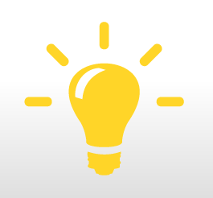
Alternative Payment Models
Medicare APMs are defined as:
  A model tested by the CMMI, other than a health care innovation award
  An ACO under the Medicare Shared Savings Program
  Certain other demonstrations under federal law
Notes:
For Medicare, the statute specifies the models listed on the slide as APMs.
Though the statute specifies MSSP ACOs as eligible APMs, it also requires that an APM bear more than nominal financial risk. Depending on how CMS defines risk, this could mean that the vast majority of MSSP ACOs that are currently enrolled in the downside risk-only track would not qualify as an APM.

Slide 15
Qualifying APM Professional
Percentage of Payments Through an APM
Notes:
This slide shows the percentages of payments that must be made through an APM to qualify for that “track.”
In 2019 and 2020, physicians would need to receive at least 25 percent of their Medicare PFS payments through an APM to qualify for the APM exemption.
In subsequent years, there is a higher threshold of payment that must be made through APMs in order for a physician to qualify. This higher threshold could be met by either Medicare PFS payments, or by total payments across all payers (including Medicare). Note that in every year, a physician will need to have a baseline of at least 25 percent of Medicare PFS payments coming through an APM to qualify. The thresholds work as follows:
In 2021 and 2122, either 50 percent of Medicare payments or 50 percent of all payments (with at least 25 percent of Medicare payments) through an APM
In 2023 and beyond, either 75 percent of Medicare payments or 75 percent of all payments (with at least 25 percent of Medicare payments) through an APM

Slide 16
Alternative Payment Models
QP
Partial QP
Eligible APM entity
Medicare APMs
Alternative payment models
Notes:
This slide shows how all the APM requirements act together to drill down to which physicians will qualify for the APM incentives:
At the bottom is the universe of alternative payment models
Under Medicare, the statute says that only certain APMs are included
Only some of the entities participating in APMs will meet the requirements to be an eligible APM entity. For example, if CMS defines “nominal risk for monetary loss” as downside risk, Track 1 MSSP ACOs will be excluded.
Among professionals provide significant care through the APM entities:
Some will meet the thresholds discussed on the prior slide and will be “qualifying professionals” and receive all APM incentives
Some may fall just short of the threshold, though they still provide a significant amount of care (exceeding slightly lower thresholds set in the statute). These physicians are considered “partial qualifying professionals.” They are exempt from the MIPS – though they can choose to participate – but do not get any other incentives for their participation in the APMs.

Slide 17
Payment Beyond 2025
APM: 0.75% annually
0.0%
MIPS: 0.25% annually
2025
2026
MIPS: Penalties or incentives of up to ± 9%
Notes:
Beginning in 2026, physicians in the MIPS will receive an annual update of 0.25 percent, while those in the APM track will receive an annual update of 0.75 percent.
Physicians/professionals in the MIPS will continue to have 9 percent of payment at risk each year, tied to performance measurement. Notice, in contrast, that the 5% bonus for those in alternative payment models goes away.

Slide 18
Physician Payment Transition – Current Law
Program | 2013 | 2014 | 2015 | 2016 | 2017 | 2018 | 2019 | 2020 | 2021 | 2022
Annual Payment Update (APU) | 0.0% | +0.5% | +0.25% | +0.5% | +0.5% | +0.5% | +0.5% | 0.0% | 0.0% | 0.0%
Medicare EHR Incentive | Variable incentive | Variable incentive | -2.0% | -2.0% | -3.0% | Max -4.0% | Folded into MIPS
Physician Quality Reporting System (PQRS) | +0.5% | +0.5% | -1.5% | -2.0% | -2.0% | -2.0%
Value-Based Payment Modifier (VM) |  |  | +1.0x OR -1.0% | +2.0x OR -2.0% | +4.0x OR -4.0% | TBD
Merit-Based Incentive Payment System (MIPS) |  |  |  |  |  |  | +/- 4.0% | +/- 5.0% | +/- 7.0% | +/- 9.0%
MIPS bonus |  |  |  |  |  |  | ≤10% | ≤10% | ≤10% | ≤10%
Alternative Payment Model (APM) |  |  |  |  |  |  | +5.0% | +5.0% | +5.0% | +5.0%
Maximum Potential Increase | 0.5% plus Variable EHR | 1.0% plus Variable EHR | 0.5% plus 1.0x | 0.5% plus 2.0x | 0.5% plus 4.0x | 0.5% plus VM | 14.5% | 15.0% | 17.0% | 19.0%
Maximum Potential Reduction | N/A | N/A | 4.5% | 6.0% | 9.0% | 9.0% | 4.0% | 5.0% | 7.0% | 9.0%
Payment Update in 2015 = 0.0% Jan 1 – June 30; 0.5% July 1 – Dec 31
CMS has discretion to set VM pool, but has not done so for 2018 and beyond
MIPS bonus payable for exceptional performance in 2020-2024
Notes:
This slide shows how the potential payment increases and reductions compare to the existing physician reporting and performance measurement programs.

Slide 19
Post-SGR Physician Payment Details
Program | 2019 | 2020 | 2021 | 2022 | 2023 | 2024 | 2025 | 2026
Annual Payment Update | +0.5% | 0.0% | 0.0% | 0.0% | 0.0% | 0.0% | 0.0% | APM: 0.75% Others: 0.25%
MIPS at-risk payment | +/- 4.0% | +/- 5.0% | +/- 7.0% | +/- 9.0% | +/- 9.0% | +/- 9.0% | +/- 9.0% | +/- 9.0%
MIPS bonus | ≤10% | ≤10% | ≤10% | ≤10% | ≤10% | ≤10%
APM (bonus) | + 5.0% | + 5.0% | + 5.0% | + 5.0% | +5.0% | +5.0%
Maximum Potential Increase | MIPS: 14.5% APM: 5.5% | MIPS: 15% APM: 5% | MIPS: 17% APM: 5% | MIPS: 19% APM: 5% | MIPS: 19% APM: 5% | MIPS: 19% APM: 5% | MIPS: 9% APM: 0.0% | MIPS: 9.25% APM: 0.75%
Maximum Potential Reduction | MIPS: 4% APM: 0% | MIPS: 5% APM: 0% | MIPS: 7 % APM: 0% | MIPS: 9 % APM: 0% | MIPS: 9 % APM: 0% | MIPS: 9 % APM: 0% | MIPS: 9 % APM: 0% | MIPS: 9 % APM: 0%
APM participants avoid penalties and in 2019-2024 receive a bonus
The maximum increase/reduction under MIPS is 9 percent in 2022 and subsequent years
Variable MIPS bonus payable for exceptional performance in 2020-2024
Notes:
This slide shows how the MACRA payment cuts and increases are implemented over the first eight years of the program.

Slide 20
Putting it all together…
How might MACRA affect me or my physician group?
Receiving APM payments?
Payments are from eligible APMs?
In first year of Medicare or below low-volume threshold?
Receiving enough payment through eligible APMs?
Exempt from MIPS
Qualify for APM track
(if desired)
Subject to MIPS
Yes
No
No
Yes
Yes
No
No
Yes
Subject to MIPS, but…
Get scoring advantage
May be exempt via “partial APM” pathway
Notes:
This slide puts all the pieces together to illustrate how a physician would figure out if he/she is in the MIPS or has qualified for the APM exemption.

Slide 21

Implications for Hospitals
Cost of implementation and compliance by employed physicians
Continued shift in hospital-physician relationships
Increased pressure on hospitals to participate in risk-bearing arrangements
What is the preferred pathway – APMs or MIPS?
  APM bonuses expire after 2025
Notes:
We expect the new physician payment system will have a number of important impacts on hospitals in the coming years. A few potential impacts have emerged from our early discussions with members.
The most directly impacted hospitals will be those that employ their physicians. Those hospitals will need to absorb the costs of compliance
But we also expect this new payment system will impact the continued shift in hospital-physician relationships. For example, some physicians may find the stability of hospital employment more appealing.
And given the significant incentives to participate in APMs, there may be more pressure from physicians for hospitals to participate in risk bearing relationships

Slide 22
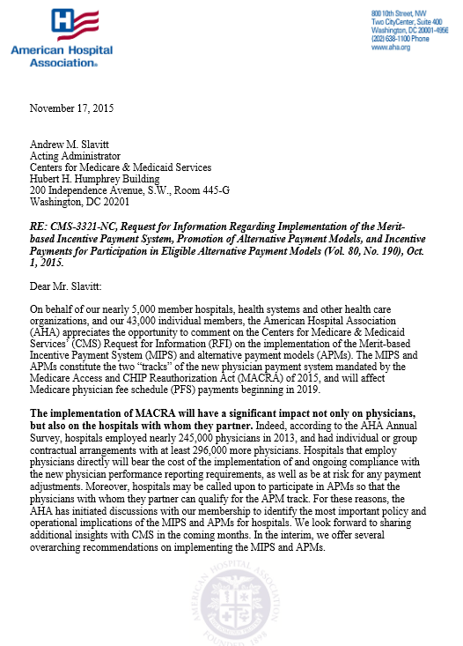
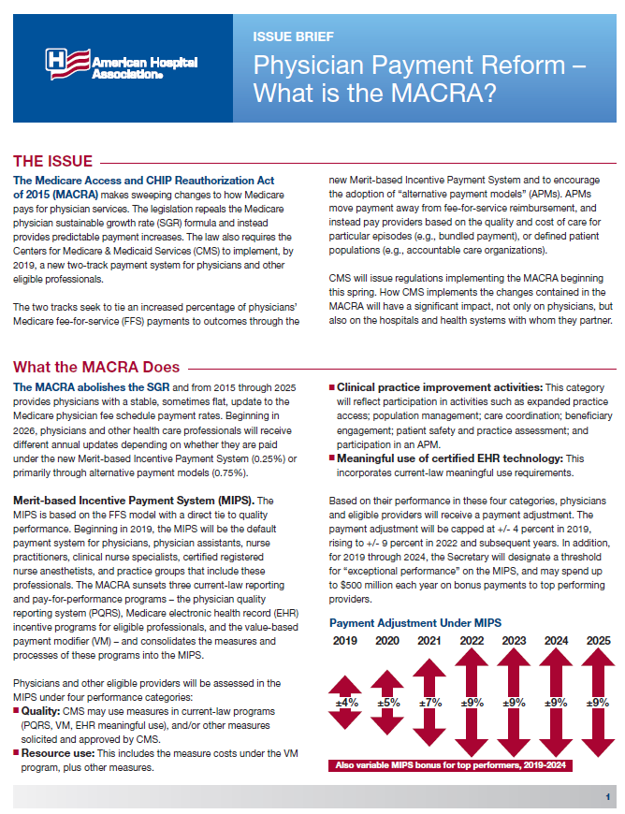
AHA Advocacy and Education
CMS Rulemaking
  RFI in Oct. 2015
  Proposed rule expected spring 2016
AHA activity
  Advocacy
  Clinical Advisory Group
  Education
Notes:
As noted at the beginning of the presentation, CMS will release a rule sometime this spring to begin implementation of the new payment system. They began that work with a request for information (RFI) released last fall. The AHA provided feedback to CMS on hospital priorities for implementation.
The AHA will continue to monitor CMS’s implementation and provide input. AHA staff are working with an advisory group of clinical leaders from among hospitals and health systems to develop our response to CMS.
In addition, AHA staff are working to educate our members and the physicians with whom they partner on the changes.

Slide 23
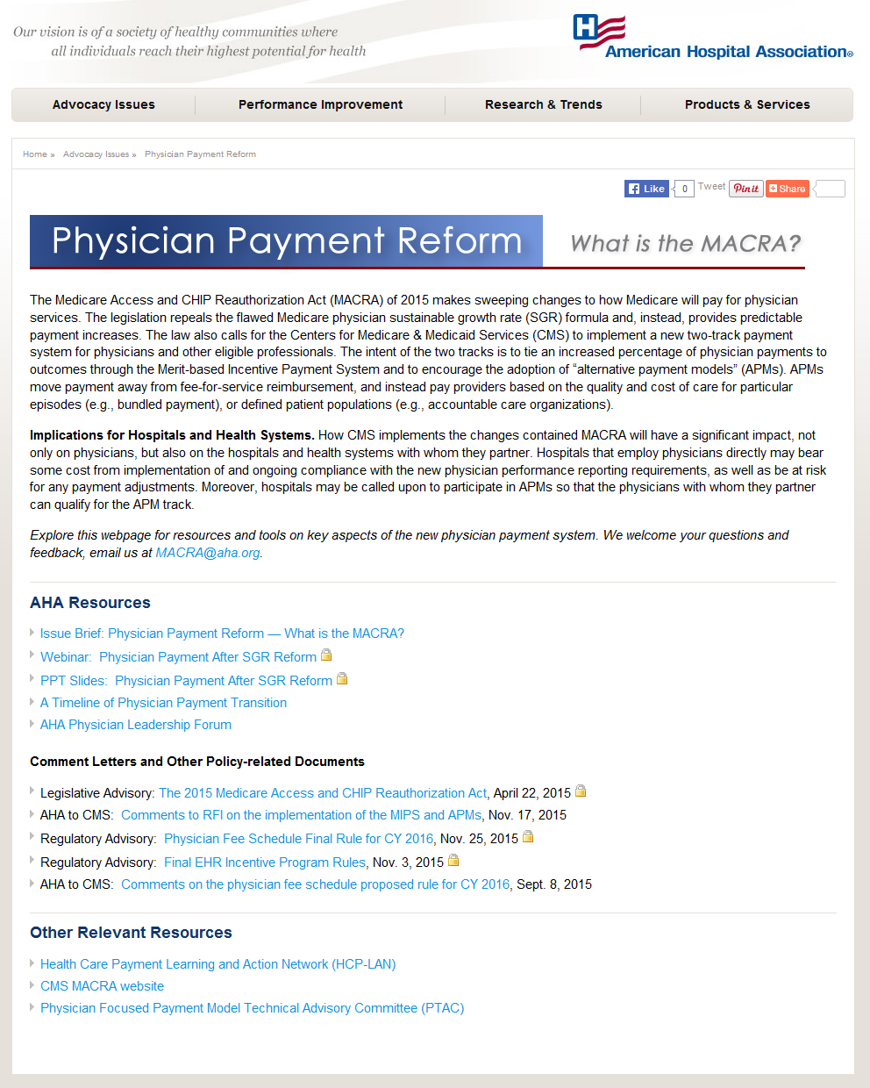
AHA MACRA Resources
http://www.aha.org/MACRA
Notes:
On the educational front, the AHA has been pulling together resources that hospital leaders can use both to educate themselves and the physicians with whom they work on the MACRA. This education is especially important since the new payment system likely will have a significant impact on hospital-physician relationships.
AHA recently launched a website with a number of resources including an ‘on demand’ webinar providing a brief overview of the MACRA, an issue brief, an implementation timeline and other helpful materials.
Please visit the website – the address is on the slide. It will be updated frequently as implementation of MACRA moves forward.
In addition, the AHA has set up a mailbox – MACRA@aha.org – where you can email AHA staff with questions and comments about the MACRA.

Slide 24
Physician Pay-for-Performance in a
Post-SGR World
Notes:
24

