Slide 1




MACRA for PAC Providers
Caitlin Gillooley
AHA Policy
November 2017
Notes:
Our objective is to get some input on resources we are planning around MACRA implementation specifically for post-acute care providers.

Slide 2
Roadmap
Review of MACRA Provisions
MACRA’s impact on PAC providers
Facility-based Reporting
AHA MACRA Resources for PAC providers
Notes:
Because post-acute care is often left out of the conversation, we’ll make sure we’re all on the same page with a quick recap of the MACRA and its quality reporting provisions. I’ll touch on how we foresee post-acute providers being impacted, both directly and indirectly, by clinician participation in the program, and then I’ll walk through the resources that we have proposed. We have a few targeted discussion questions at the end.

Slide 3
Physician Quality Payment Program
Starting in 2019….
PQRS
VM
MU
MIPS
APM
Notes:
Just as a quick reminder, the MACRA passed last year. In addition to eliminating the deeply flawed SGR formula for physician payments, it established a new, two-track physician Quality Payment Program (QPP) in 2019. That program does two things:
Consolidates three previously separate programs into one (the Merit-Based Incentive Payment System, or MIPS) and;
Provides incentives for participation in APMs.
Taken together, these programs are an aggressive step in moving the field from volume to value.

Slide 4
Payment Under MACRA
APM: Bonus of 5% of PFS payments annually
APM
0.75% annually;
no bonus payments
MIPS OR APM
0.0% annual update
2019
2020
2021
2022
2023
2024
2025
2026
MIPS
0.25% annually, PLUS penalties/bonus up to ± 9%
±4%
±5%
±7%
±9%
±9%
±9%
±9%
±9%
Notes:
This slide illustrates the payment impact under MACRA over the next several years. The middle line is the base annual payment update. As you can see, from 2020 through 2025, it is zero percent, and a physician’s payment updates depend on their MIPS and APM performance.
The amount at risk for MIPS goes up until it reaches 9 percent in 2022 and beyond.
APM bonuses available through 2024, then go away.
In 2026, higher base payment updates for APM participants, but no bonus.

Slide 5

Merit-based Incentive Payment System
MIPS is default payment system
Applicable to physicians, PAs, NPs, CNSs and CRNAs beginning in 2019
  Others can be added in 2021
Participate as individual or group practice
Exemptions for:
  Certain participants in alternative payment models
  Clinicians in first year of Medicare
  Low-volume threshold
Notes:
The MIPS will be the default payment system for physicians, physician assistants, nurse practitioners, certified nurse specialists, and certified registered nurse anesthetists beginning in 2019. CMS may choose to expand the payment system to other professionals paid under the fee schedule (such as physical, occupational, speech therapists) beginning in 2021.
Clinicians may participate at individuals or as part of group practices. For the purposes of the MIPS, each unique combination of NPI and TIN is treated as an individual. Group practices are defined as multiple NPIs billing under a single TIN.
Certain professionals will be exempted from the MIPS and its associated reporting requirements. Those include:
Qualified APM participants, which will be physicians who receive a certain percentage of payments through the APM.
“Partial” APM participants, who receive some payments through an APM but not enough to qualify as APM participants, and who do not report measure data under the MIPS. CMS will need to provide more definition on who fits in to this category.
Professionals who do not meet a low-volume threshold that will be determined by CMS. We will talk about that in a minute.

Slide 6
MIPS: Performance Categories
Category | CY 2019 | CY 2020 | CY 2021 and beyond
Quality | 60% | 50% | 30%
Resource use (Cost) | NA* | 10% | 30%
Clinical practice improvement activities | 15% | 15% | 15%
Advancing Care Information (i.e., Meaningful Use) | 25% | 25% | 25%
*CMS invoking statutory flexibility to not score cost category in first year
Notes:
The MIPS includes four categories of performance, each of which is assigned a weight (read the categories).
It is important to note that for the first year, cost performance will not be tied to MIPS incentives or penalties. CMS chose to invoke statutory authority to alter the weightings of the categories in specific circumstances. As a result, in the first year, 60% of performance is tied to quality, 15 percent is tied to improvement activities, and 25 percent to ACI.
Clinicians who fail to meet reporting requirements of a particular category receive the lowest possible score in that category. So for example, if a professional does not submit quality data, they would receive the lowest score in the quality category

Slide 7
MIPS: Quality Measures
Replaces PQRS
Report 6 quality measures, including an outcome measure, for a minimum of 90 days
Report via administrative claims, payment claims, Excel spreadsheet (Down/uploadable CSV), CMS web interface, EHR or qualified clinical data registry
Potential for facility-level measures fulfilling requirements for facility-based clinicians
Notes:
A few more specifics on the MIPS program: as we mentioned, this part of the MACRA will replace the physician quality reporting system, or PQRS. Physicians will have to choose from a MIPS-specific list of quality measures and report on 6 of them; at least one must be an outcome measure. There are about 270 measures from which to choose, and providers also have several channels through which they can report their quality data. There’s a downloadable CSV spreadsheet that they can upload in the CMS QPP website, they can report directly into the web interface, they can use their EHR data, or, if the clinician already reports data to a qualified clinical data registry, their reporting requirements are fulfilled.
One item I’ll note that we raised in the discussion paper as well is that we have urged CMS to allow facility-based clinicians to use their facility’s quality measure outcomes to fulfill these requirements. In the forthcoming proposed rule on MACRA, which should be coming out over the summer, we will see how CMS responds to our request on hospital-based reporting; if they are open to that, they will likely support post-acute facility-based reporting as well.

Slide 8
Advanced APM Criteria
Advanced APM
Require use of certified EHR technology
Tie payment to quality
Require downside risk
Notes:
To be designated an advanced APM, a model must meet certain criteria.
The criteria were generally set in statute, those some details were up to interpretation by CMS in the final rule.
The model must:
Require use of certified EHR technology
Tie payment to quality
Require downside risk. Note that although the statute uses different language (require “more than nominal risk” for financial loss), CMS is interpreting this as downside risk.

Slide 9
Advanced Alternative Payment Models
Models that qualify in 2018:
MSSP Track 2
MSSP Track 3
Next Generation ACO
Comprehensive ESRD Care
Oncology Care Model (two-sided track)
Comprehensive Primary Care Plus (as medical home)
Comprehensive Care for Joint Replacement (CJR)
MSSP Track 1+
Notes:
Applying CMS’s interpretation of the criteria to existing models, you will see that a very limited number of models qualify as advanced APMs for 2017.
The most common disqualifier is the financial risk standard. The Bundled Payments for Care Initiative (BPCI) would not qualify because it doesn’t tie payment to quality measures, and the Comprehensive Care for Joint Replacement (CJR) – the joint replacement bundle mandatory for hospitals in some markets – does not include an EHR requirement. The others are disqualified because of the financial risk standard.
In particular, there are very few options for hospital-driven models to qualify.
For example, though hospital-led ACOs make up about 50% of the MSSP, most participants are in Track 1. Similarly, a number of hospitals participate in BPCI – and some hospitals were mandated to take financial risk through the CJR. And as we discussed on the last slide, most hospital-driven medical homes that participate in the CPC+ program will not qualify after 2017.
We are disappointed that those efforts will not be recognized in the first year.
CMS has indicated an interest in expanding availability of advanced APMs going forward:
In the new hospital bundled payment rule released in August, CMS proposed to create two tracks for participation in the new cardiac and hip facture bundles, and to create two tracks in CJR. In each, Track 1 would allow qualification as an advanced APM by incorporating an attestation of certified EHR technology use.
CMS also is considering a new ACO model that would incorporate less downside risk than the models currently available (“Track 1+). Few details were provided, however.
Overall, CMS has projected that only between 5-8 percent of clinicians will qualify for the APM incentives in year 1.

Slide 10
Implications for PAC Providers
Direct
Indirect
PAC Providers who Employ Physicians
PAC Industry as a Whole
Employed physicians will experience up to 18% swing in payments
Physicians may need assistance in complying with reporting requirements:
  Data/IT
  Care management
  Billing
  Operations
Enhanced focus on coordinated care increases importance of collaboration with PAC settings
ACI requirements make interoperable EHRs a priority
Physicians responsible for quality measures will demand better transfer of information
APMs likely to look for efficient, cost-effective PAC partners
Notes:
Direct impact: employed physicians experience up to 18% swing in payments
Indirect impacts: general acute-care providers need to establish post-acute care strategy, partnerships, interoperability, efficiency, especially around bundles, additional demand for transfer of information

Slide 11
CY 2018 MACRA Final Rule
Non-Facility Based Clinicians
Individual/group performance on 6 measures for one year¹
Individual/group average of total cost per capita, MSPB, episode cost measures
Facility-Based Clinicians
Converted hospital VBP total performance score
Participation in up to 4 activities
Participation in up to 4 activities
90-day compliance with Meaningful Use requirements
Converted hospital VBP total performance score
90-day compliance with Meaningful Use requirements
Quality
Resource Use²
MIPS Performance Categories
Improvement Activities
Advancing Care Information
¹These are general requirements and might differ depending on a clinician’s participation in various programs.
²This category is not being scored for CY 2017 (CY 2019 performance); it will apply for CY 2020.
Notes:
In the CY 2018 proposed rule on MACRA, CMS laid out a new option for providers who mainly deliver care in the general acute-care hospital space. This is an option we advocated for and we support the inclusion of facility-based reporting in the MACRA as this will help clinicians and hospitals better align quality improvement goals and processes across the care continuum and reduce data collection burden.
If a clinician were to elect the facility-based reporting option for the Merit-based Incentive Payment System, or MIPS, he or she would still be evaluated on the four performance categories– quality, resource use, improvement activities, and advancing care information. However, instead of individual performance on 6 quality measures and an average of several cost measures, these clinicians would receive a score based on their facility’s value-based purchasing total performance score.

Slide 12
Facility-Based Reporting Details
Eligibility
  Facility-based clinicians of any specialty with at least 75% of covered professional services provided in IP or ED settings
  Based on claims with POS codes 21 (IP) and 23 (ED)
Option Election
  Voluntary election
  Required election by measure submission deadline
Notes:
To be eligible for this reporting option, clinicians would have to provide at least 75% of their covered professional services in inpatient and/or emergency department settings. CMS would determine whether clinicians meet this threshold by considering the place of service, or POS, codes on the clinicians’ claims. Codes 21, which denotes the inpatient setting, and 23, which denotes the emergency department setting, would be included in this determination. We note that POS code 22, the on-campus hospital outpatient setting, was NOT proposed for inclusion by CMS in this option, although we contend that it should be and commented as such.
Clinicians may choose whether or not they want to elect the facility-based reporting option once CMS notifies them that they are eligible.

Slide 13
Facility-Based Reporting Details, cont.
Attribution
  Scores based on hospital where clinicians provide services to most Medicare beneficiaries using same performance period
  If equal at multiple facilities, score tied to highest-scoring facility
VBP Score Conversion
  Clinicians placed in same percentile of performance in quality and cost categories as hospital receives on TPS in VBP program
Notes:
If clinicians perform 75% of their covered professional services in the facility setting, but have done so across multiple facilities, they will receive a score based on the hospital where they have served the most beneficiaries. CMS would use the same claims data to attribute clinicians to a specific hospital as they did to determine eligibility for the reporting option.
For the score, a clinician would be assigned the same percentile on the MIPS quality and cost performance categories as the hospital performed in the VBP program– so in other words, if the hospital’s total performance score was in the 60th percentile in the VBP program, the clinicians would receive MIPS quality and cost scores corresponding to the 60th percentile.

Slide 14
Implementation Framework
Implementation Issue | Recommendation
Mandatory or optional participation | Participation should be voluntary and mutually desired by clinician and facility
Facilities included | Facilities considered in option should include not just hospitals, but also post-acute facilities including IRFs, SNFs, LTCHs, and HHAs as well as inpatient psychiatric facilities
Attribution of clinicians to facilities | Facilities and clinicians should be able to self-designate using registration process
Eligibility thresholds | Eligibility threshold should be same (75%) as IP/ED; POS codes considered eligible should include 31 (SNF/LTCH), 51 (inpatient psych) and 61 (IRF)
Scoring approach | Clinicians should be permitted to select individual facility-level program measures most relevant to their practice
Notes:
We do believe there are still some details to work out with the facility-based reporting option, and we raised those issues in our comment letter. An additional issue we put forth for CMS’s consideration is to expand this reporting option to a broader array of facility types in the future, including post-acute care facilities. This is particularly important considering the significant gaps in available MIPS quality and cost measures that meaningfully reflect the practice in these facilities. While not all facilities have a VBP program, each post-acute care setting does participate in a pay for performance quality program from which CMS could draw performance measures.
As we advocate for this option, we have developed a set of recommendations that we believe CMS should consider if they do expand this reporting option.
First, we believe that, as with the general acute-care setting, the facility-based reporting option for post-acute care providers should be optional. There should also be a registration process that would ensure that both the clinicians electing this option and the facility in which that clinician primarily practices are both aware and in agreement of the clinician’s election of the facility-based reporting option.
Next, we think CMS should consider including all post-acute care facilities in this option, which would comprise inpatient psychiatric facilities, SNFs, IRFs, LTCHs, and HHAs.
Similarly, the eligibility threshold should be determined based on POS codes, as it has been proposed in the inpatient/ED setting. These codes could include 31 to cover SNF and LTCH services, 51 for inpatient psychiatric facilities, and 61 for the IRF setting.
Finally, we suggest that CMS should allow clinicians to choose the facility-level program measures most relevant to their practice. For example, a rheumatologist might not choose to be evaluated on the facility’s functional assessment measure, but rather on a set of functional outcomes measures that more truly reflect the specialist’s work with the patient.

Slide 15
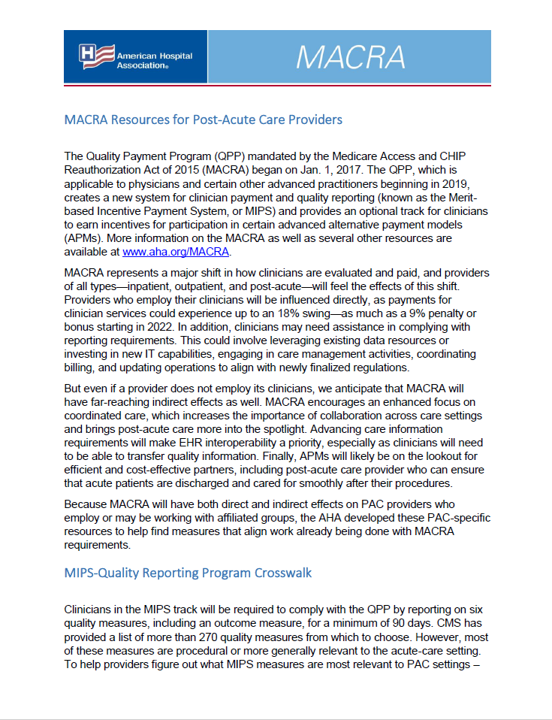
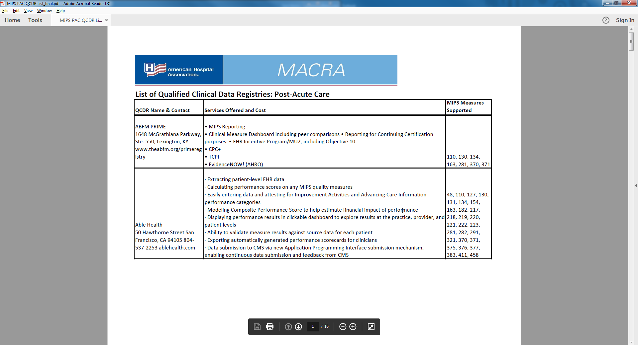
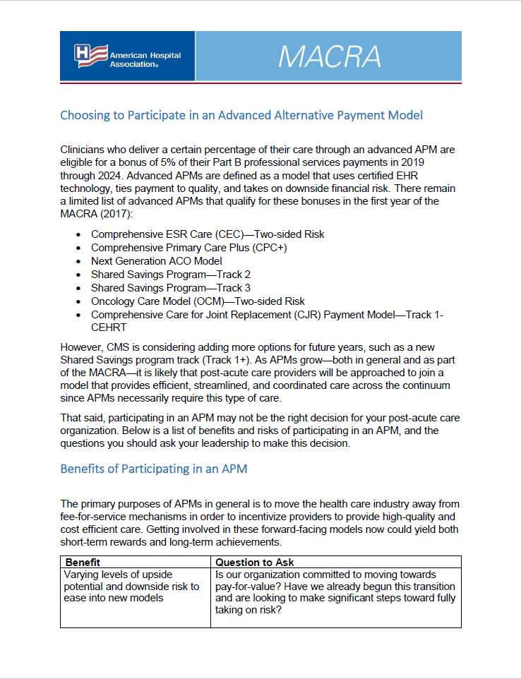
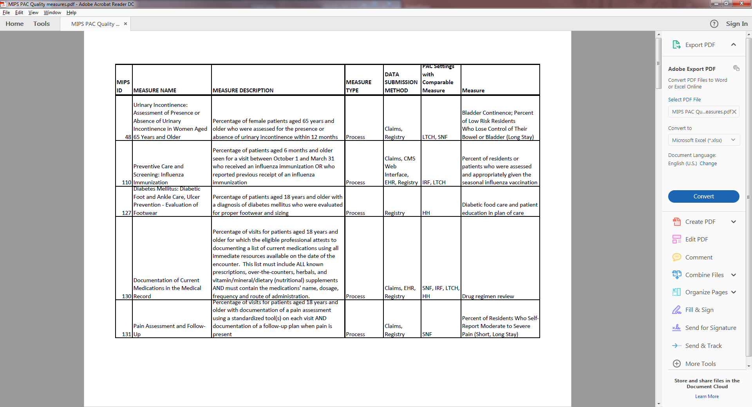
MACRA for PAC Resources
Notes:
With those potentially significant impacts in mind, we have put together a plan for a suite of resources specifically designed for post-acute providers to help their clinicians with MACRA implementation. We have started developing these tools, but are eager for feedback on what you think would be most helpful for your organizations and the clinicians with whom you work.

Slide 16
MACRA for PAC Resources:
Resources One-Pager
Background on Act, link to AHA MACRA page
Explanation of MACRA impact on post-acute care
Overview of each tool and when/how to use
Notes:
One concern we have heard from post-acute members is that the list of quality measures included in the MIPS list of about 270 that I mentioned are mostly procedural or generally relevant to the acute-care space. To help providers figure out what measures they can feasibly report, either because the specifications for the MIPS measure match those for measures already required in post-acute QRPs or because they are collecting similar data that could be leveraged to fulfill a certain measure, we plan to create a crosswalk between the QPP measures and the QRP measures. The crosswalk would look like this, where we indicate which measures could be fulfilled with data reported in the PAC QRP, and match those measures with setting-specific measures.

Slide 17
MACRA for PAC Resources:
MIPS/QRP Crosswalk
Name and description of MIPS measure
Measure type and submission method
List of PAC settings with same/similar measure
PAC Quality Reporting Program measure
Notes:
One concern we have heard from post-acute members is that the list of quality measures included in the MIPS list of about 270 that I mentioned are mostly procedural or generally relevant to the acute-care space. To help providers figure out what measures they can feasibly report, either because the specifications for the MIPS measure match those for measures already required in post-acute QRPs or because they are collecting similar data that could be leveraged to fulfill a certain measure, we plan to create a crosswalk between the QPP measures and the QRP measures. The crosswalk would look like this, where we indicate which measures could be fulfilled with data reported in the PAC QRP, and match those measures with setting-specific measures.

Slide 18
MACRA for PAC Resources:
Qualified Clinical Data Registries
33 QCDRs that support PAC-relevant measures
Name and contact information of registry
Info on organization, services offered, cost
List of PAC-relevant measures supported
Notes:
In this example, we’ve populated our list with the American academy of neurology registry, which supports individual clinician reporting of data that is subsequently publicly reported on Medicare’s Physician Compare website. We walked through the measures reported to the AAN and matched those that are on that list of 270 MIPS measures. Finally you’ll see additional information about the registry, like additional services provided and any cost. This could be a helpful resource for clinicians

Slide 19
MACRA for PAC Resources:
Choosing to Participate in an AAPM
Background on APMs, including 2017 models
Sections on benefits and risks of APM participation
Questions for consideration
Additional organizational considerations

Slide 20
MACRA for PAC Providers
Caitlin Gillooley
AHA Policy
cgillooley@aha.org

