Slide 1
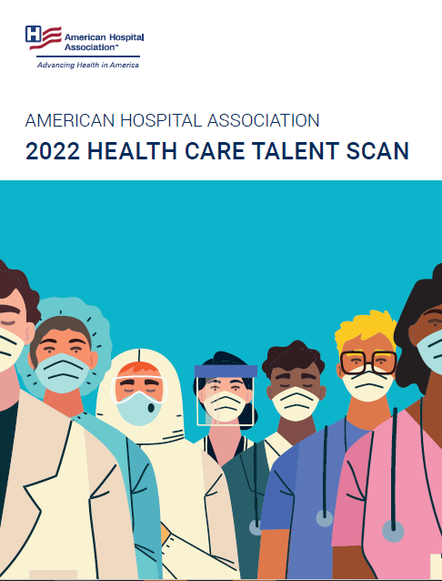
What is the AHA Health Care Talent Scan?
An annual snapshot of health care employment
Expert recommendations on recruiting, training, retaining and supporting health care workers
A path for hospitals navigating familiar and emerging workforce challenges
Notes:
Annual snapshot of health care employment that consolidates data from multiple reports, studies and other sources.
Features insights, innovative action strategies, questions and expert recommendations on recruiting, training, retaining and supporting health care workers.
Helps hospitals navigate familiar and emerging workforce challenges as we move forward from the COVID-19 pandemic into our new normal, recognizing that our dedicated workforce is the backbone of our health care system.

Slide 2




Health Care Trends Affecting Workforce Planning
Long-term prospects for hospitals’ economic stability
Cultural changes associated with behavioral health
A move toward diversity, equity and inclusion strategies
The emergence of new technology in care models
Notes:
Re-establishing economic stability for hospitals will be a long-term process.
Cultural changes will likely lessen the stigma associated with behavioral health, but much work remains to be done to improve access and better integrate it into all care across the continuum.
Diversity, equity and inclusion strategies are critical to ensuring the health care needs of all populations are equitably served and represented.
Technology, including virtual health, will play a pivotal role in new care models.

Slide 3

Focus Area #1: Clinician Well-being
Pandemic added and exacerbated stressors
Front-line clinicians need help to cope and feel safe, valued and engaged
Unique opportunity to reexamine and reframe approaches to fostering thriving workforces
Normalize help-seeking behavior, nurture resilience, promote self-care, cultivate joy
Notes:
The pandemic added a barrage of COVID-related stressors while also exacerbating the impact of the chronic ones that threaten clinician well-being.
Compassionate, holistic support and services are vital to helping front-line clinicians cope and feel safe, valued and engaged.
We have a unique opportunity to reexamine and reframe core approaches to fostering a thriving workforce.
Effective strategies include normalizing help-seeking behavior, nurturing resilience, promoting self-care and cultivating joy.

Slide 4

Focus Area #2: Education, Training and the Evolving Practice Landscape
New clinician training must be revamped and ramped up
Skills must meet what’s needed for new delivery models (i.e., team-based care, telemedicine)
Creative in-person and virtual learning opportunities must be offered; diverse learning styles must be supported
Notes:
In the short term, we need to revamp and ramp up new clinician training to address gaps created due to the pandemic disrupting education.
Longer term, we need to rethink training, retraining and upskilling of current and future clinicians to develop the skill sets and enhanced resilience required for delivery models such as team-based care and telemedicine.
Offering creative in-person and virtual learning opportunities and better supporting diverse learning styles will enhance workforce agility and clinical education equity.

Slide 5
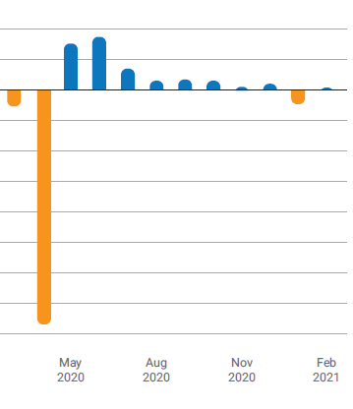
Focus Area #3: Keeping Pace with Future Demand
Recruitment and retention must remain top priorities
Volatility in physician, nursing workforce buoyed by increases in medical school applications, enrollment in BSN degree programs
Adopt multifaceted workforce-building approach to
Address clinician needs
Remain attractive to millennial/Gen Z clinicians
Strengthen diversity recruiting
Notes:
Recruitment and retention must remain top priorities, especially since the pandemic has amplified existing clinician shortages.
Physician workforce volatility has increased, and nursing vacancies, turnover and costs are up.
On the plus side, medical school applications and enrollment in BSN degree programs are higher.
Take advantage of a multifaceted workforce-building approach that includes tailoring solutions to clinician needs, cultivating an attractive environment for millennial and Gen Z clinicians, and strengthening diversity recruiting.

Slide 6

Build a Thriving Workforce in the New Normal
Consumerism, technology and societal factors that impact health continue to redefine the health care environment
Workforce planning must integrate with strategic planning
Rely on the AHA Health Care Talent Scan to prepare for and embrace change
Notes:
Key forces such as consumerism, technology and societal factors that impact health continue to redefine the health care environment.
As a result, it is increasingly essential to integrate workforce planning with strategic planning.
The AHA Talent Scan can help you deepen your understanding of the existing and emerging challenges your clinicians face so that you can better help them – and your organization – prepare for and embrace change.

Slide 7

Additional Resources
The AHA offers a wide variety of
workforce development resources including:
Relevant news, reports and white papers
Links to upcoming conferences and webinars
Archives of past events
Case studies
Visit www.aha.org/workforce

