Slide 1
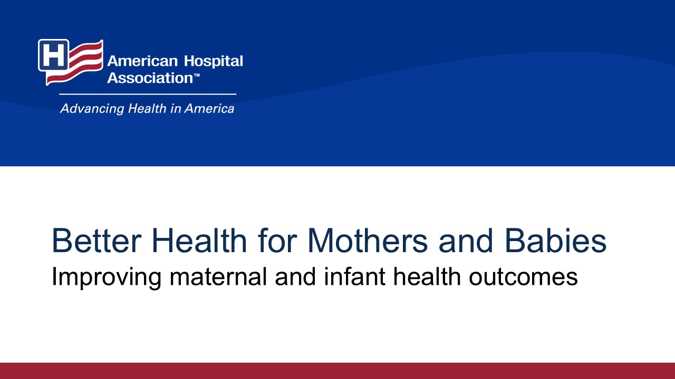
Notes:
Maternal health is a priority for U.S. hospitals and health systems. This presentation, brought to you by the American Hospital Association’s Better Health for Mothers and Babies Initiative, highlights how hospitals and health systems can work toward improving maternal and infant health outcomes.

Slide 2
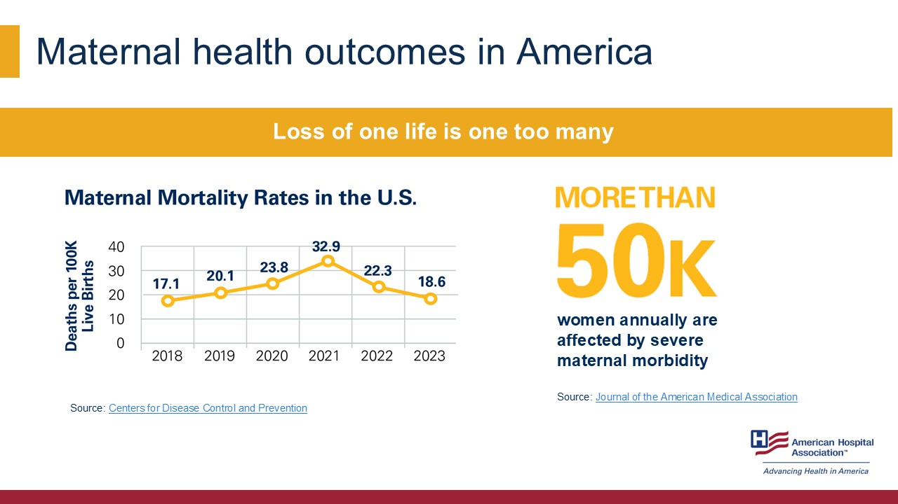
Notes:
Despite medical advances, too many women are injured or die from pregnancy complications. Each year, more than 50,000 women experience severe maternal morbidity — which are unexpected and life-threatening complications.
Maternal mortality rates have more than doubled since 1987 in the United States, from 7.2 deaths per 100,000 live births to 18.6 deaths per 100,000 live births in 2023. This is in stark contrast to other developed countries – who have seen a tremendous decrease in maternal mortality rates in the same time period.
Losing one life is one too many. The AHA’s goal is to ensure all women experience a safe, healthy pregnancy and birth.
Sources:
https://www.aha.org/bhmb/infographic
https://ww.cdc.gov/nchs/data/hestat/maternal-mortality/2023/maternal-mortality-rates-2023.htm
https://jamanetwork.com/journals/jamanetworkopen/fullarticle/2806478

Slide 3
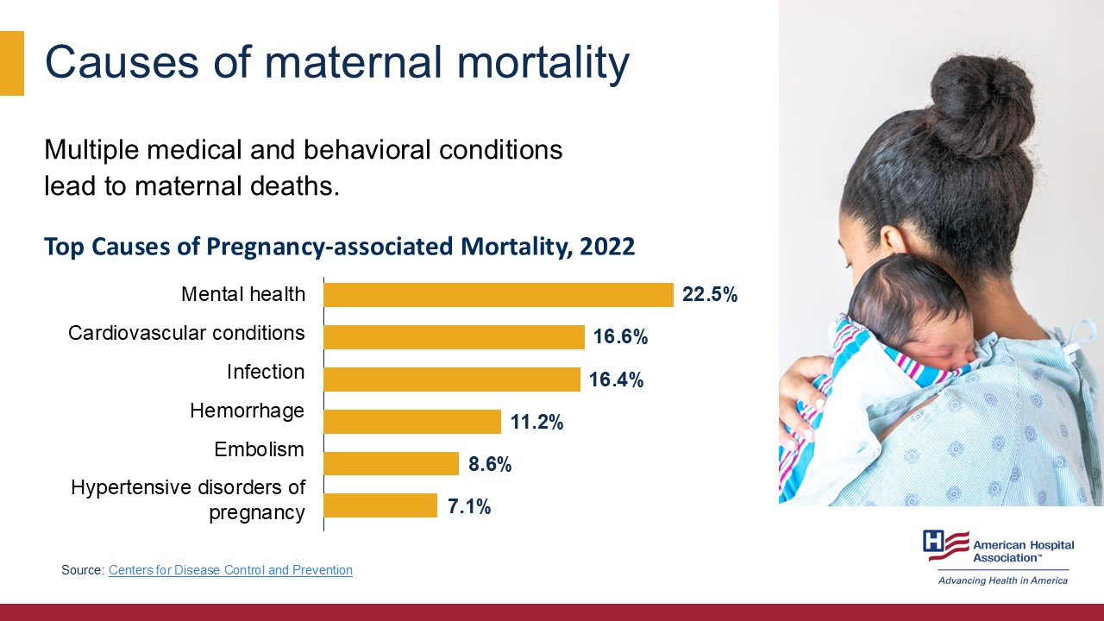
Notes:
Pregnancy-related deaths are complex and result from both medical and behavioral conditions. The leading causes in 2022 included mental health conditions, cardiovascular issues and infections. This data highlights the need for comprehensive, multidisciplinary care throughout the perinatal period.
Source:
https://www.cdc.gov/maternal-mortality/php/data-research/index.html

Slide 4
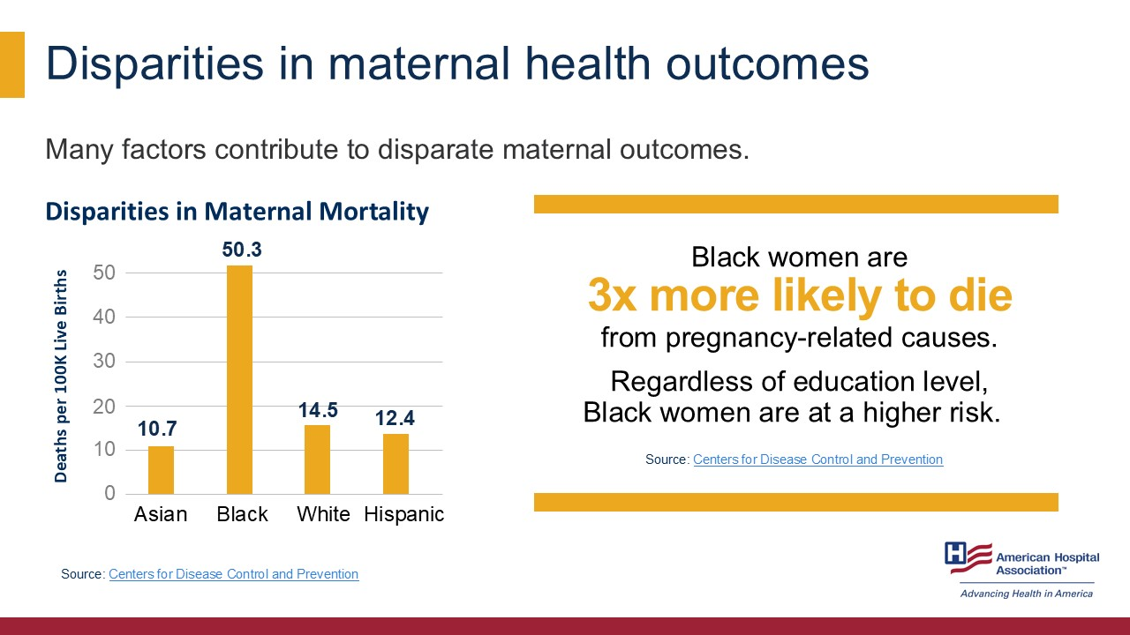
Notes:
Not all women experience pregnancy equally — there are stark disparities by race, ethnicity, education, geography and socioeconomic conditions. Black women are 3 times more likely to experience a pregnancy-related death than their white counterparts. In fact, college-educated Black women are 5.2 times more likely to die from pregnancy-related issues than white women with the same educational attainment and 1.6 times higher than the rate for white women with less than a high school diploma.
This underscores the importance of addressing disparities in maternal care.
Sources:
https://www.cdc.gov/nchs/data/hestat/maternal-mortality/2023/maternal-mortality-rates-2023.htm
https://www.cdc.gov/mmwr/volumes/68/wr/mm6835a3.htm

Slide 5
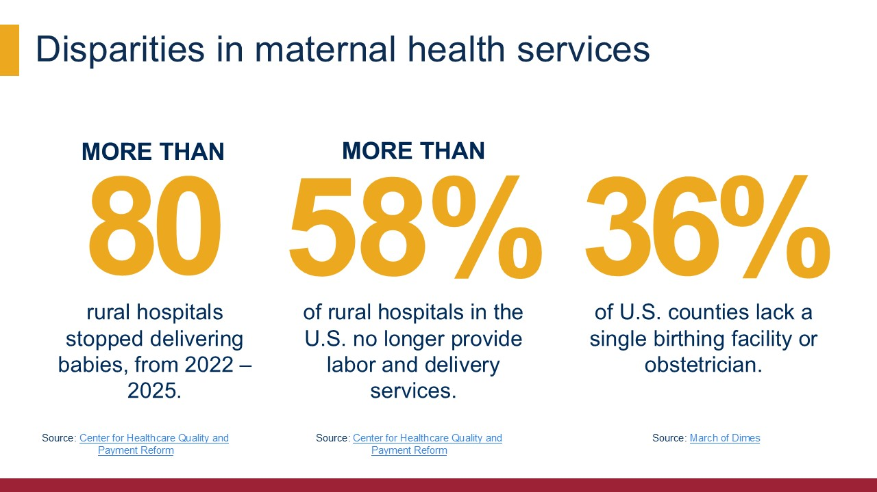
Notes:
Accessing prenatal and postpartum care is often burdensome for rural women. Over 2.3 million women of reproductive live in areas with no access to maternal care, and 36% of U.S. counties are considered “maternity care deserts” as they do not have a single birthing facility or obstetric clinician.
Between 2022 and 2025, more than 80 rural hospitals stopped delivering babies. More than half (58%) of rural hospitals in the U.S. no longer provide labor and delivery services. These factors contribute to worse outcomes and must be addressed in our maternal health improvement strategies.
Sources:
https://www.marchofdimes.org/maternity-care-deserts-report
https://chqpr.org/downloads/Rural_Maternity_Care_Crisis.pdf

Slide 6
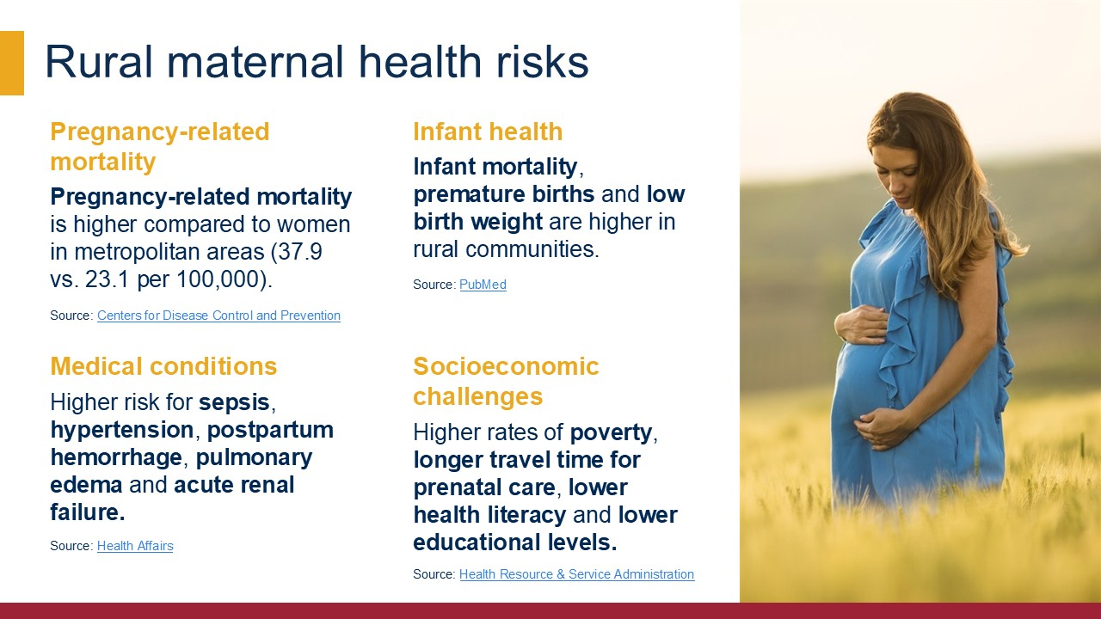
Notes:
Pregnancy outcomes for rural women are significantly worse than their urban counterparts. Pregnancy-related mortality is higher in women in rural areas, with 37.9 pregnancy-related deaths per 100,000 compared to 23.1 deaths per 100,000 in metropolitan areas.
Rural women also experience disparities in maternal morbidity, including increased risk of sepsis, hypertension, postpartum hemorrhage, pulmonary edema, and acute renal failure. Rates of infant mortality, premature births and low birth weight are also elevated in rural communities. These factors are exacerbated by numerous social and economic issues including higher rates of poverty, longer travel time for prenatal care, lower health literacy and lower educational levels.
Sources:
https://www.cdc.gov/maternal-mortality/php/pregnancy-mortality-surveillance
https://www.healthaffairs.org/doi/10.1377/hlthaff.2019.00805
https://pubmed.ncbi.nlm.nih.gov/17300477
https://www.hrsa.gov/sites/default/files/hrsa/rural-health/rmoms-fy19-program-summary.pdf

Slide 7
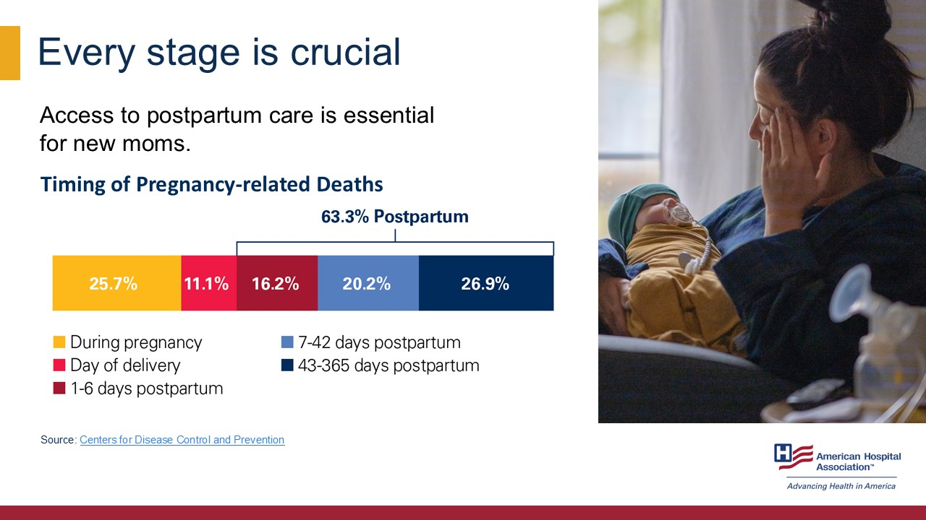
Notes:
Data tells us nearly two-thirds of pregnancy-related deaths occur in the postpartum period — up to one year after birth. In fact, only 36% of pregnancy-related deaths take place during pregnancy or on the day of delivery. A focus on clinically based solutions will not be sufficient to address the full scope of challenges associated with maternal mortality. Addressing continuity of care and postpartum coverage are critical to preventing these avoidable tragedies.
Source:
https://www.cdc.gov/maternal-mortality/php/data-research/index.html

Slide 8
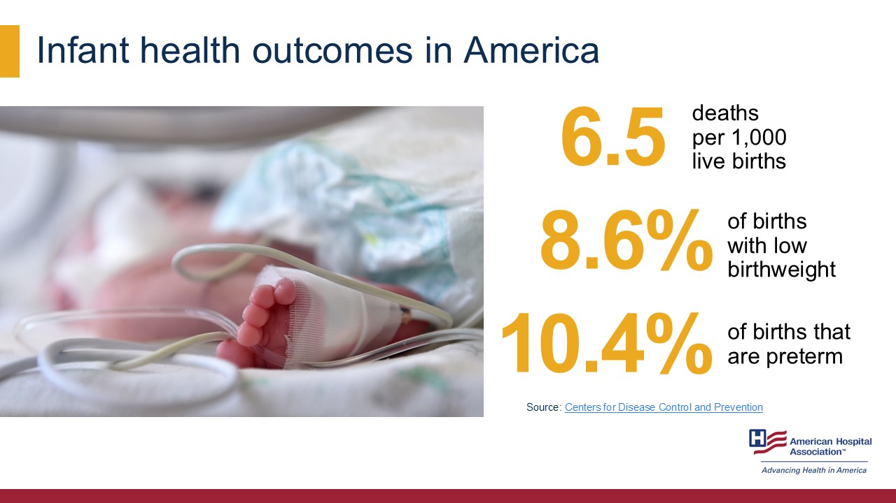
Notes:
The U.S. also faces ongoing challenges in infant health, with high rates of preterm births, low birthweight and infant mortality. Many of these outcomes are preventable and tied closely to maternal health and access to care.
Source:
https://www.cdc.gov/nchs/fastats/infant-health.htm

Slide 9
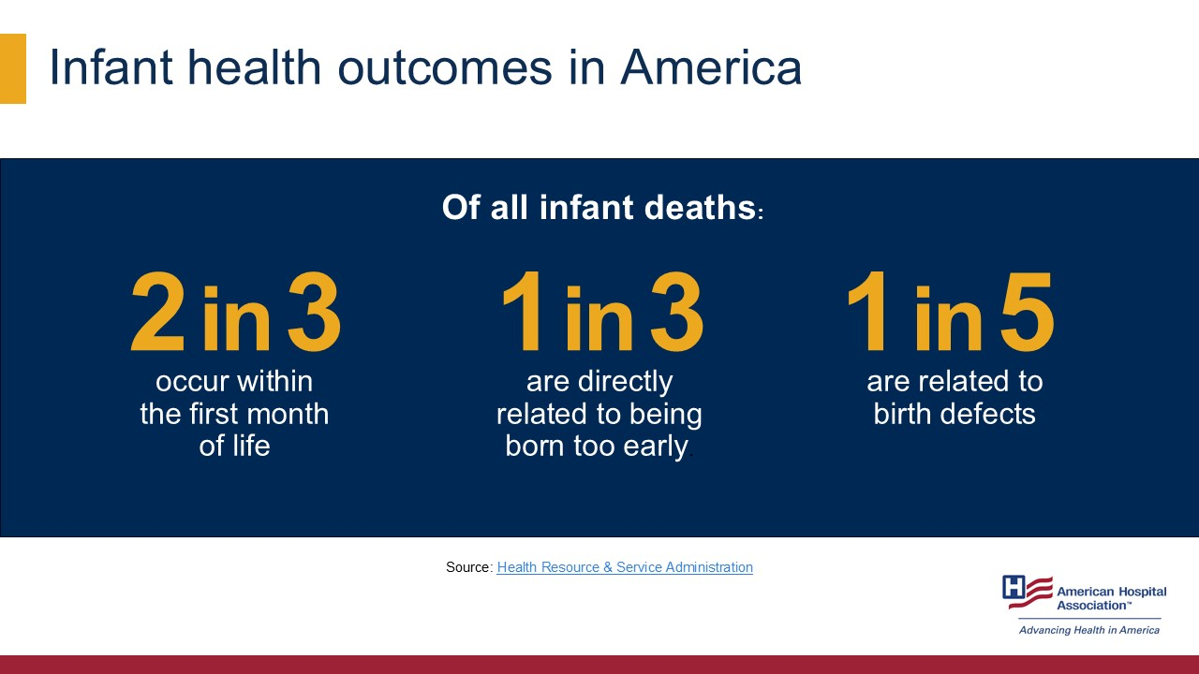
Notes:
Most infant deaths happen in the first month of life, with prematurity and birth defects being leading causes. This tells us that interventions need to start early — ideally during pregnancy.
Source:
https://mchb.hrsa.gov/programs-impact/focus-areas/infant-health

Slide 10
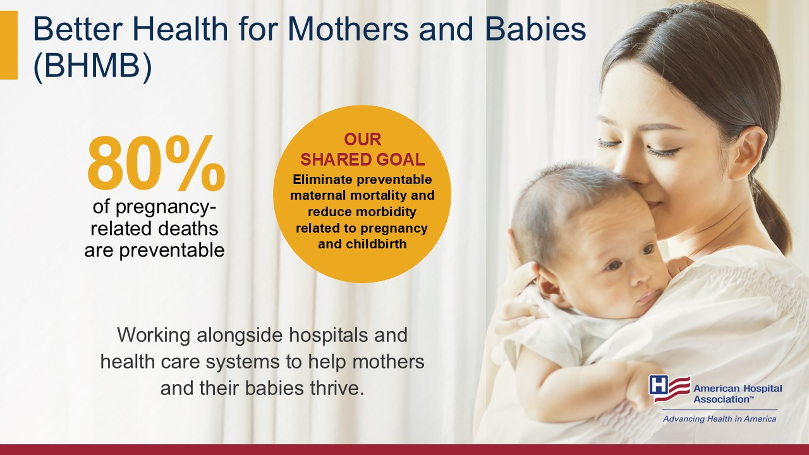
Notes:
More than 80% of pregnancy-related deaths are preventable. U.S. hospitals and health systems must work toward solutions and strategies focused on saving as many lives as possible.
Through the American Hospital Association’s Better Health for Mothers and Babies Initiative (BHMB), the AHA is working alongside hospitals and health systems to help mothers and their babies thrive. Our shared goal is to eliminate preventable maternal mortality and reduce morbidity related to pregnancy and childbirth.
Learn more:
https://www.aha.org/bhmb

Slide 11
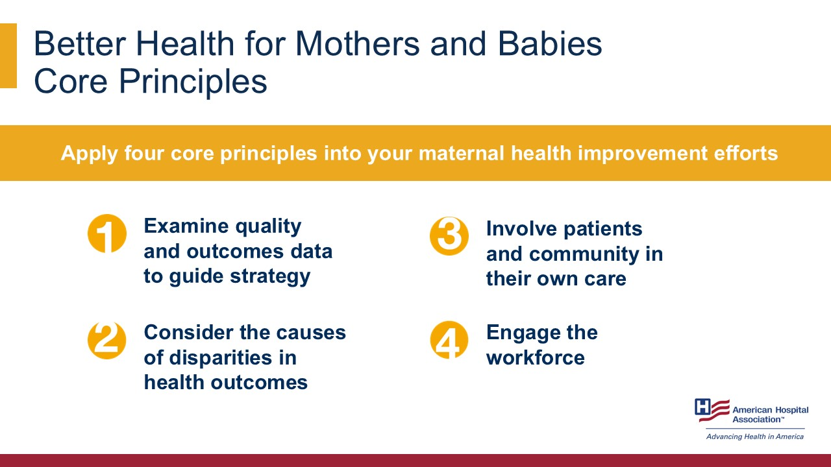
Notes:
The Better Health for Mothers and Babies initiative is guided by four core principles:
Examine quality and outcomes data to guide strategy. Hospitals can systematically collect data, review metrics and identify disparities to drive strategies for improvement in health outcomes.
Consider the causes of disparities in health outcomes by investigating how clinical and community-based strategies work toward reducing disparate outcomes.
Involve patients and community in their own care. By engaging patients, families and community stakeholders in designing care, we can ensure it is responsive to their needs and preferences.
Engage the workforce by deploying interdisciplinary care teams who are trained to provide person-centered care.
The AHA encourages hospitals and health systems to apply four core principles into their maternal health improvement efforts. Each of these is essential for a holistic and effective approach to eliminate preventable maternal mortality and reduce morbidity.
Learn more:
https://www.aha.org/bhmb

Slide 12
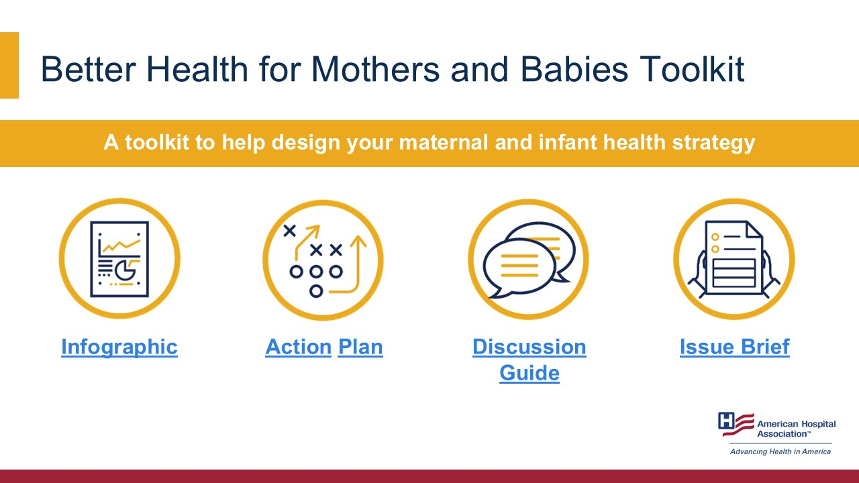
Notes:
To help hospitals take action, the AHA offers a toolkit including an infographic, action plan, discussion guide and issue brief. These resources make it easier to implement improvements within a hospital or health system.
Sources:
https://www.aha.org/bhmb/infographic
https://www.aha.org/bhmb/action-plan
https://www.aha.org/bhmb/discussion-guide
https://www.aha.org/bhmb/issue-brief

Slide 13
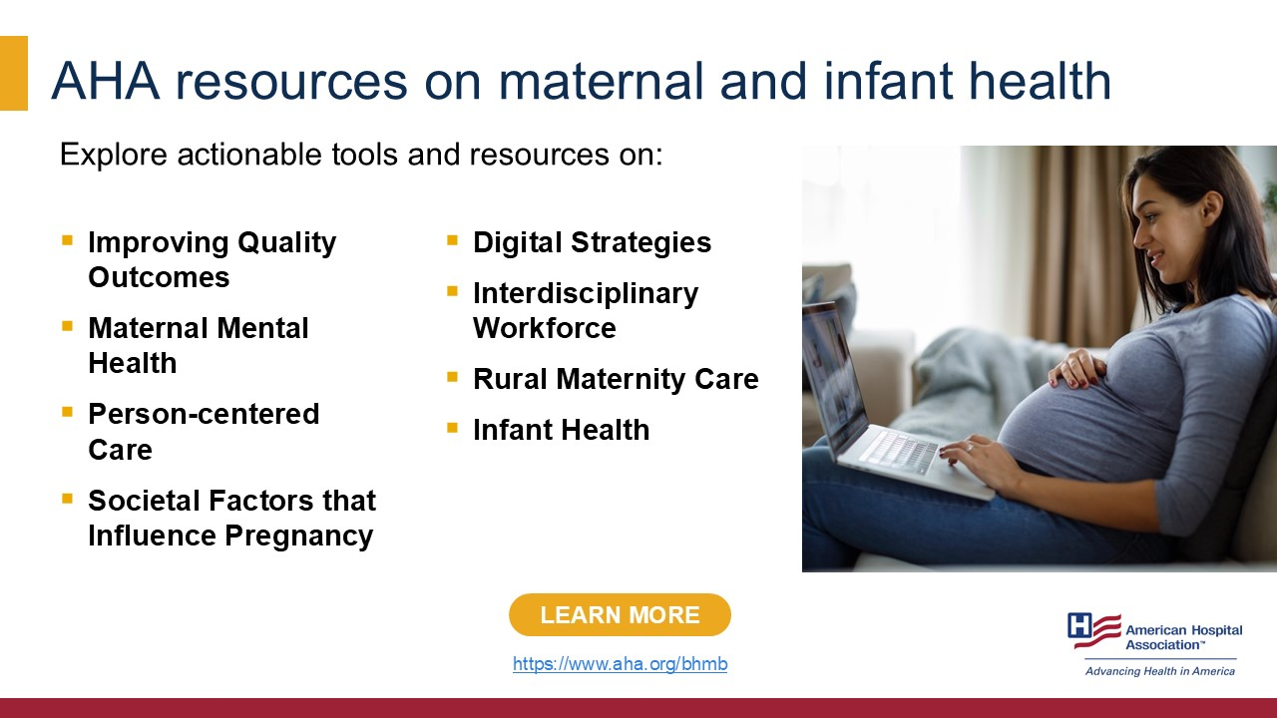
Notes:
The AHA also provides extensive resources to support hospitals as they address challenges and opportunities in maternal and infant care. Resources range on topics such as care models and digital strategies, to interdisciplinary workforce and rural maternal care.
These tools and resources also highlight promising strategies hospitals are implementing to drive real-world improvement.
Learn more:
https://www.aha.org/bhmb

Slide 14

Notes:
Hospitals across the country are already putting the Better Health for Mothers and Babies’ core principles into action. The next set of slides showcases some key action steps hospitals can take to implement each of the four core principles. The slides also highlight some case examples from the field.
Learn more:
https://www.aha.org/bhmb/action-plan

Slide 15
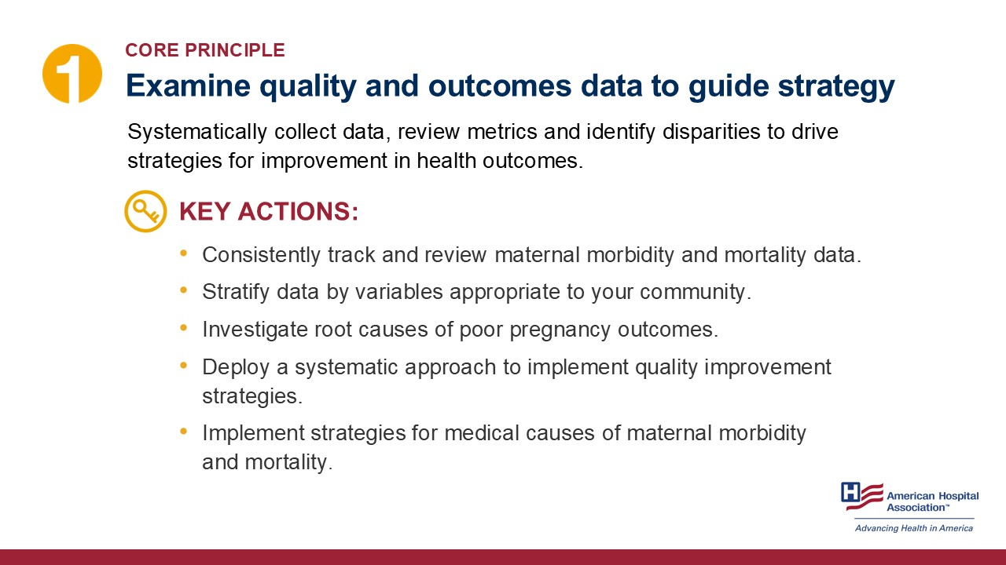
Notes:
To improve outcomes, we need to understand the data behind them. Hospitals should track maternal data consistently, stratify it by demographic variables and identify patterns that require intervention.
Learn more:
https://www.aha.org/bhmb/action-plan

Slide 16
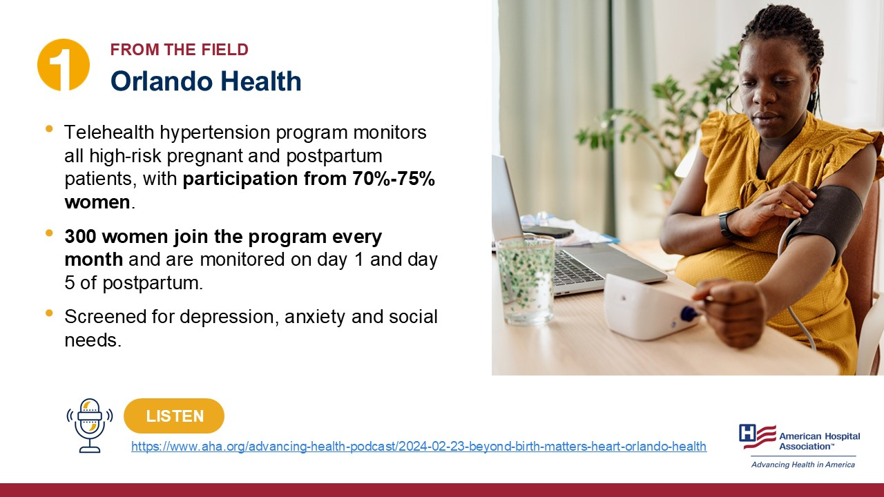
Notes:
For example, Orlando Health’s telehealth program identifies and monitors high-risk postpartum women for hypertension and mental health, provides them early education and intervention, and gives them access to resources, leading to fewer complications. 300 women join the program every month and are monitored on day one and day five of postpartum to detect hypertension early. Patients are also screened for depression, anxiety and social needs.
Learn more:
https://www.aha.org/advancing-health-podcast/2024-02-23-beyond-birth-matters-heart-orlando-health

Slide 17
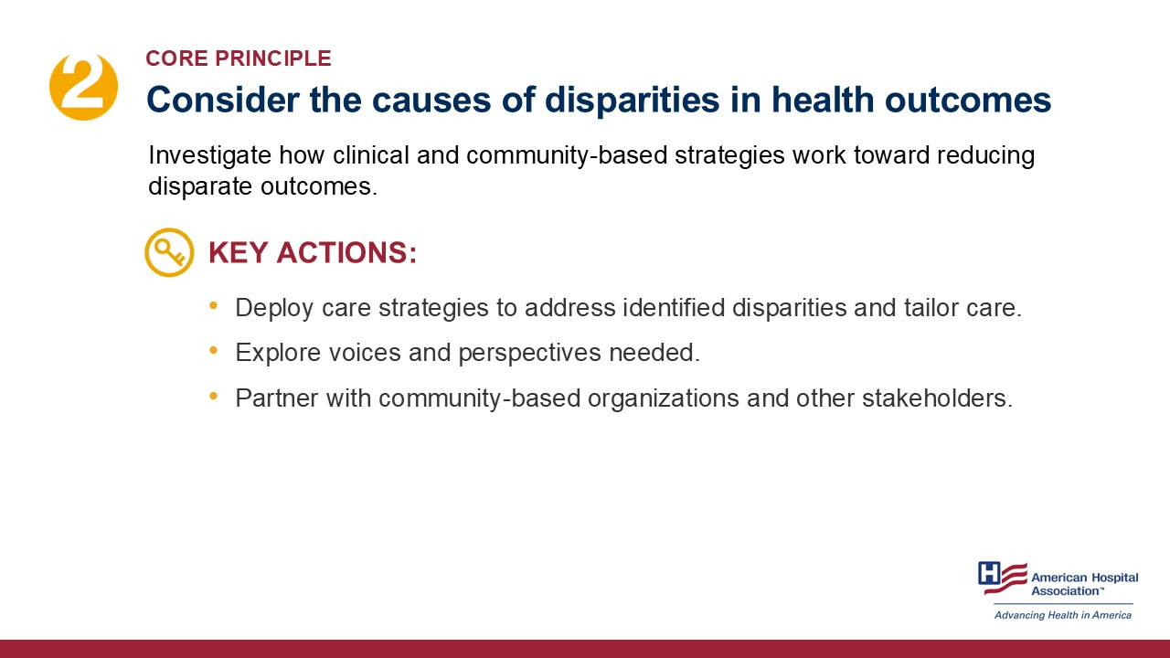
Notes:
While we can identify disparities using data, hospitals must be intentional about addressing them with targeted strategies. This may involve actively exploring the voices and perspectives of the patients and communities. Hospitals can also form partnerships with community-based organizations and other key stakeholders. This allows hospitals to enhance the effectiveness of interventions by leveraging local knowledge, skills and resources, create and strengthen support systems within the community.
Learn more:
https://www.aha.org/bhmb/action-plan

Slide 18
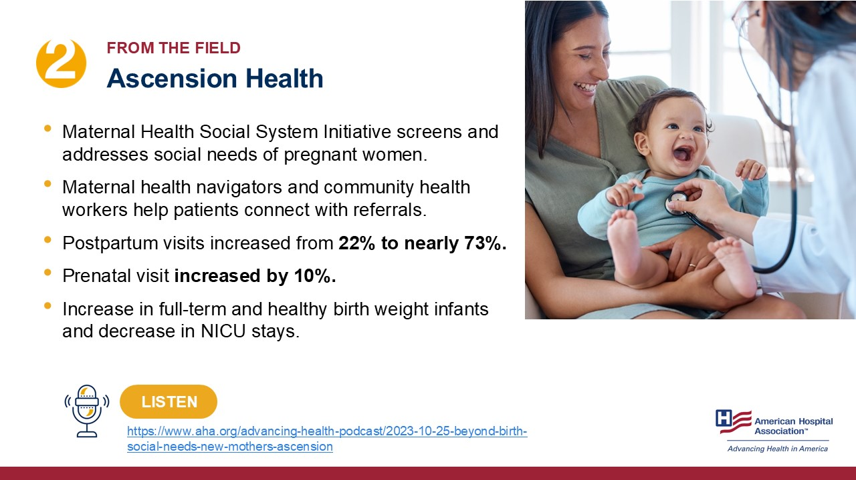
Notes:
Ascension’s Maternal Health Social System Initiative focuses on screening and addressing the social needs of pregnant patients through the support of maternal health navigators and community health workers. These professionals provide referrals for services like education, food and transportation through phone calls, clinic visits and home visits. The numbers of referrals provided increased through this program.
The initiative has led to other significant improvements, including a rise in postpartum visit completion rates from 22% to nearly 73% and a 10% increase in prenatal visit completions.
Besides more referrals and fewer missed appointments, the program saw more full-term and healthy birth weight infants and a reduction in NICU stays.
Learn more:
https://www.aha.org/advancing-health-podcast/2023-10-25-beyond-birth-social-needs-new-mothers-ascension

Slide 19
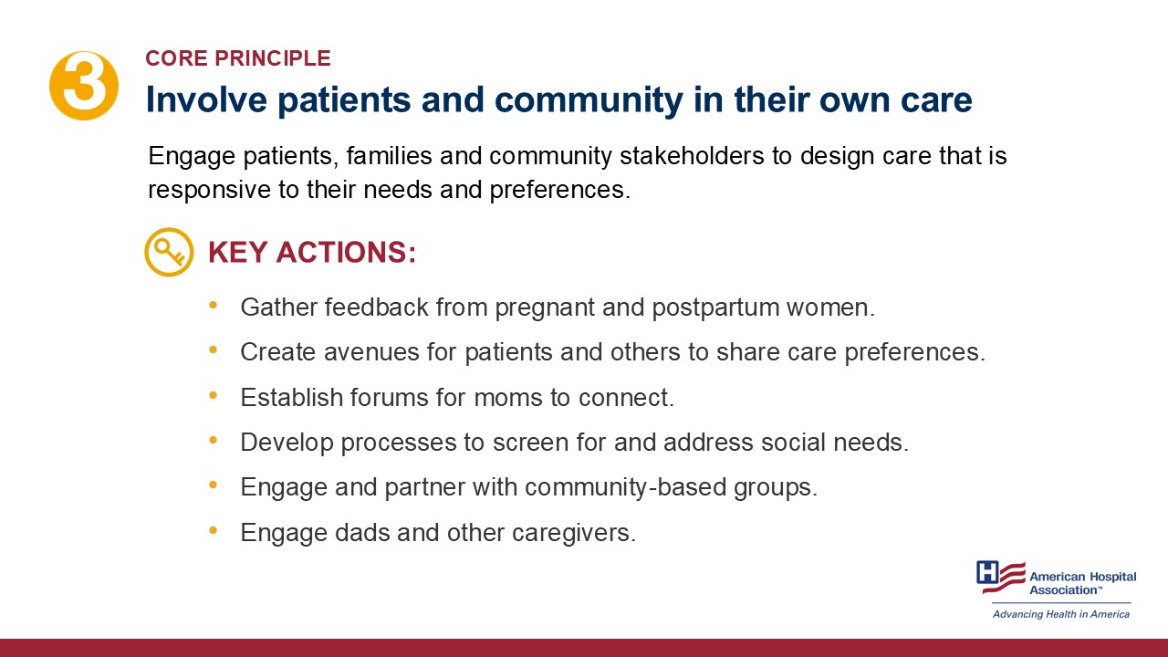
Notes:
To design care that is truly responsive to the needs and preferences of patients, hospitals should actively engage pregnant and postpartum women, their families and community stakeholders.
Some steps hospitals can take involve gathering direct feedback from women during pregnancy and after childbirth to better understand their experiences and needs. Hospitals can create accessible avenues for patients to share their care preferences and ensure their voices are heard and respected. One way could be establishing forums where mothers can connect and support one another, which fosters a sense of community and shared understanding.
In addition, hospitals can develop structured processes to screen for and address social needs, which is crucial for providing holistic support. Partnering with community-based organizations also enhances the reach and impact of care. Strategies should also include caregivers and fathers, as they play a significant role in creating a supportive environment for the entire family.
Learn more:
https://www.aha.org/bhmb/action-plan

Slide 20

Notes:
St. Louis Children’s Hospital’s Raising St. Louis program supports pre- and post-natal families with children ages 0 to 4 through multidisciplinary home visitation teams and early childhood development education. The program also includes dedicated courses specifically for fathers. The program has engaged 744 babies and their families, providing comprehensive support during early childhood. The program also plans to expand support by incorporating doulas into the program, aiming to further enhance care for new moms and families.
This podcast with St. Louis Children’s is one of a four-part podcast series, Caring for Our Kids. The podcast series is produced by the AHA’s Advancing Health podcast channel. The series focuses on how pediatric hospitals meet the needs of their communities and includes first-hand experiences from pediatric patients themselves.
Learn more:
https://www.aha.org/advancing-health-podcast/2025-02-12-caring-our-kids-raising-st-louis-helping-families-thrive

Slide 21
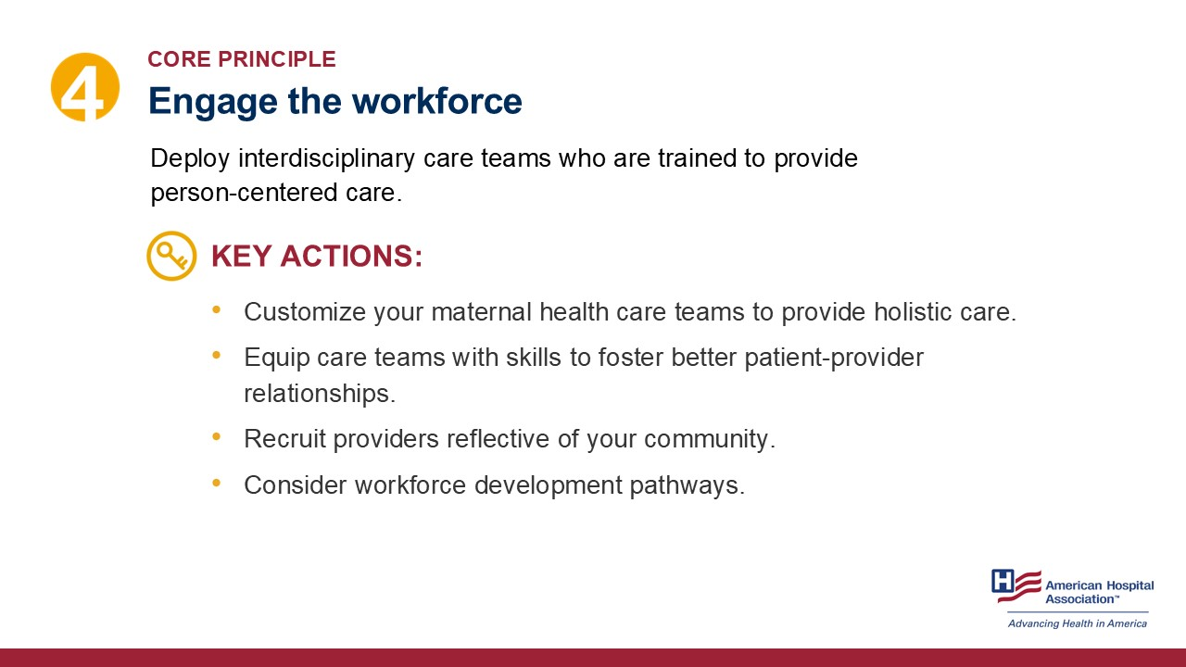
Notes:
To enhance maternal health outcomes, it is essential to engage the workforce by deploying interdisciplinary care teams trained to deliver person-centered care. Actions hospitals can take are to customize teams of nurse-midwives, doulas, community health workers and behavioral health specialists to ensure holistic support tailored to the specific needs of the patient population.
Hospitals can equip care team members with skills to foster active, empathetic interactions between patients and providers. Additionally, hospitals can recruit providers who reflect the community and invest in workforce development pathways. These strategies can help build trust among patients and improve care quality.
Learn more:
https://www.aha.org/bhmb/action-plan

Slide 22
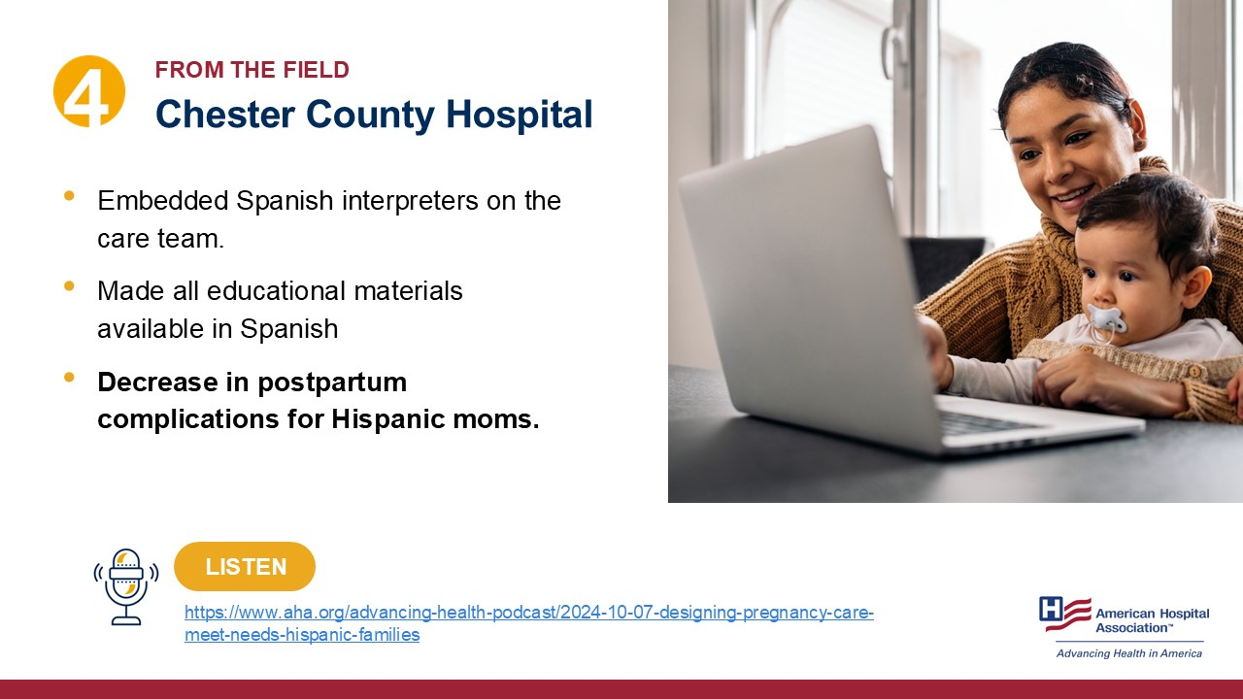
Notes:
Chester County Hospital improved outcomes for Hispanic mothers by embedding Spanish interpreters directly into the care team and ensuring all educational materials were available in Spanish. These efforts led to a notable decrease in postpartum complications, demonstrating the impact of person-centered care.
Learn more:
https://www.aha.org/advancing-health-podcast/2024-10-07-designing-pregnancy-care-meet-needs-hispanic-families

Slide 23
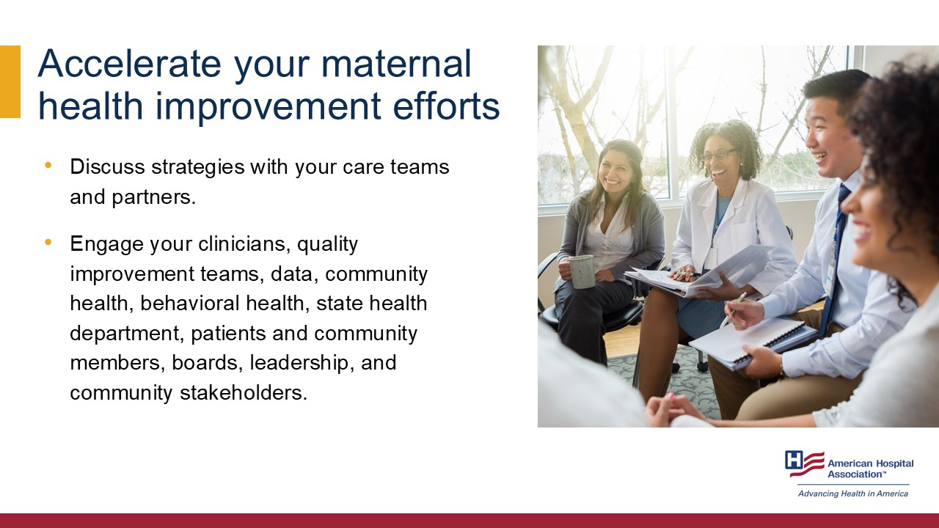
Notes:
While hospitals play a critical role in improving maternal and infant health outcomes, these action steps cannot be implemented in isolation. To accelerate improvement, it is essential to engage in meaningful discussion and collaboration with care teams and a broad range of partners to develop and sustain effective strategies. This includes involving clinicians, quality improvement teams and data analysts to identify gaps and track progress, as well as engaging community health and behavioral health professionals to address patients’ social and emotional needs.
Partnerships with state health departments can support alignment with public health goals and provide additional resources. Equally important are discussions with patients, families, community members, hospital leadership, boards and local stakeholders to ensure that strategies are grounded in the real needs of the population and have broad support. Through a coordinated approach, hospitals can drive lasting improvements in maternal and infant health outcomes.

Slide 24

Notes:
As part of the Better Health for Mothers and Babies initiative, the AHA has developed a discussion guide to help teams of health care leaders, clinicians, quality improvement leaders, lay health care providers, patients, community stakeholders and health care administrators, etc., to come together, reflect, discuss and strategically identify gaps and opportunities to advance their pregnancy and postpartum care strategies.
The discussion guide is aligned with the four core principles. Let’s dive into core principle one.
When examining quality and outcomes data, here are a few things care teams can discuss and evaluate:
How are you tracking maternal and infant morbidity and mortality data?
Which sociodemographic variables are collected and tracked?
Do you see opportunities to improve care during pregnancy, labor and delivery, and the postpartum period?
What quality and performance improvement strategies do your organization employ or participate in?
Learn more:
https://www.aha.org/bhmb/discussion-guide

Slide 25

Notes:
Let’s dive into core principle number two.
When it comes to understanding and addressing disparities in health outcomes, care teams can identify gaps and opportunities by discussing issues such as, but not limited to, the following:
What non-clinical needs are most prominent in your perinatal patients and families?
How are you identifying and addressing person-centered care?
How do you assess the impact of processes and programs? What feedback do you collect?
What community-based organizations are you partnering with?
How is improving maternal health outcomes designated on your organization’s strategic plan?
Learn more:
https://www.aha.org/bhmb/discussion-guide

Slide 26
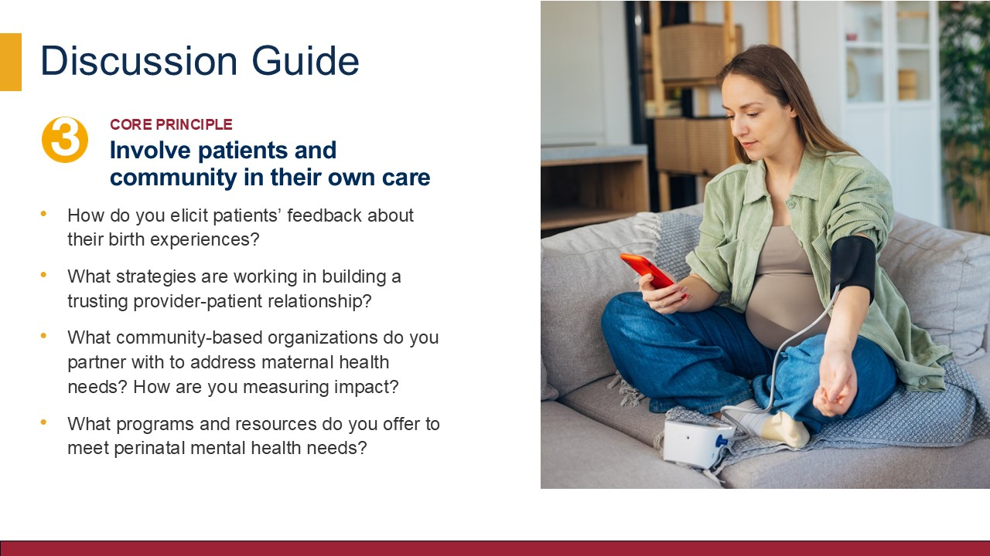
Notes:
Health care must be responsive to the unique needs and voices of patients, and hospitals need structures that allow patients and families to participate in shaping their care. This is key for the third core principle.
Hospitals can analyze their strategies on patient and community engagement by discussing a few things:
How do you elicit patients’ feedback about their birth experiences?
What strategies are working in building a trusting provider-patient
relationship?
What community-based organizations do you partner with to address maternal health needs? How are you measuring impact?
What programs and resources do you offer to meet perinatal mental health needs?
Learn more:
https://www.aha.org/bhmb/discussion-guide

Slide 27

Notes:
The fourth core principle is focused on engaging the workforce.
We know that a well-trained and interdisciplinary workforce is foundational in delivering high-quality care. Engage hospital leadership, administration, board members and others in conversations around:
What types of professionals might be missing from the care team?
What kind of continuing education/training do you offer for person-centered care?
How are you building a strong workforce pipeline?
What challenges are you facing in employing interdisciplinary health care professionals?
Learn more:
https://www.aha.org/bhmb/discussion-guide

Slide 28
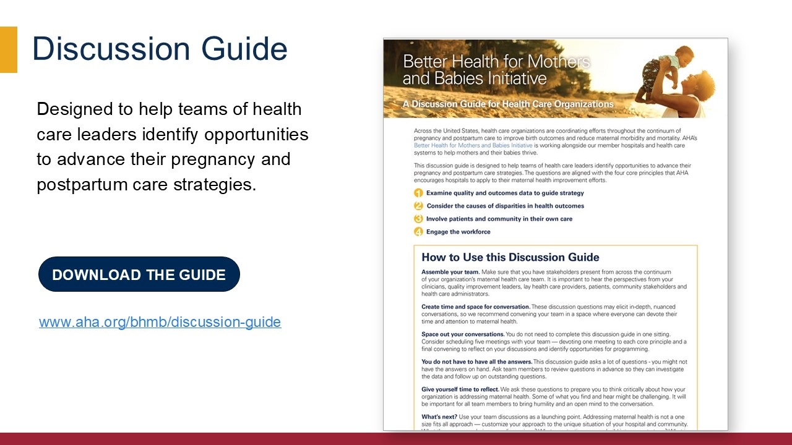
Notes:
The Better Health for Mothers and Babies discussion guide is designed to help teams of health care leaders identify opportunities to advance their pregnancy and postpartum care strategies.
To learn more and find tips for using the Better Health for Mothers and Babies discussion guide, you can visit the website to download the guide.
Learn more:
https://www.aha.org/bhmb/discussion-guide

Slide 29

Notes:
In addition to the Better Health for Mothers and Babies toolkit and resources, the AHA pursues strategies and supports public policies aimed at improving maternal and child health access and outcomes. To learn more, visit the MCH website.
Learn more:
https://www.aha.org/maternal-health-advocacy-updates

Slide 30
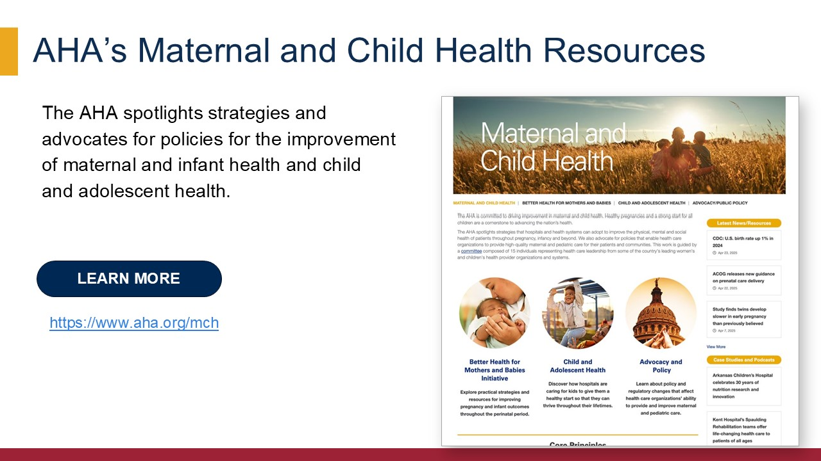
Notes:
Lastly, in addition to maternal care, the AHA also offers resources and advocates for policies for child and adolescent health. Visit www.aha.org/mch to learn more.
Learn more:
https://www.aha.org/mch

